Slide 1
Validity in
Generative Research
Paul de Lacy
Professor Emeritus, Rutgers University
http://www.pauldelacy.net
delacy@rutgers.edu
University of Auckland, 11 Feb 2020

Slide 2
Issue
Should we trust the evidence that has been presented for Generative theories?
… of the phonological module (PhM) in particular?
  To what extent?
I will argue that
  I don’t know
  There are principled reasons for my uncertainty
Methodological validity, reliability, and accuracy
Without validity, reliability, and accuracy, there is no way to evaluate theories
  … Almost: apart from internal consistency

Slide 3
Where to start?
What does it mean for a method to be “valid”?
Construct valid:
  There is a strong theoretical reason for believing that our method should produce relevant evidence
Reliable
  The method, repeated over and over, yields the same results
Accuracy and Precision
  A reliable method’s results get us within a particular distance of the right result (accuracy), and are within a particular range (precision)

Slide 4
Reliability
Reliable
  If you measure the same thing over and over, you get the same result
Phonological theories of metrical stress largely rely on grammars for evidence
  Grammars are largely reports of the impressions of an L2-learner.
Is this ‘Grammar Method’ valid?
Or, at least, is it reliable?
4

Slide 5
GM-internal consistency #1: Mapudungun (de Lacy 2014)
 | Echeverria & Contreras 1965 | Smeets 1989 | Zúñiga 2006
CVCV words | Free variation | Lexical stress | Final stress
Secondary stress | Every second V | Every second V and every final V | Either the first or second σ
Main stress | Second syllable | Penult; Two in longer words(?) | Penult or final
Open/closed | Final closed σs attract secondary stress | Final closed or penultimate open | Closed syllables attract main stress
Lexical stress | In particles | In some suffixes and some CVCV words | No
5
Notes:
He came up with this useful chart.
As you can see, casting your eye over it, there is a lot of disagreement about most things from the various authors.

Slide 6
GM-consistency #2: Gujarati (Shih 2018)
Source | a | ɛ ɔ e o | u | i | ə
Adenwala 68
Cardona 65: 3σ Doctor 04
Cardona 65: 2σ de Lacy 02/06 Masica 91
Schiering & van der Hulst 10
Mistry 97
Modi 13
Pandit 58 Patel & Mody 60
* My thanks to Shu-hao Shih (Rutgers University) – see Shih 2018, Shih & de Lacy 2020.

Slide 7

Shu-hao Shih’s Gujarati experiment (2018)
Final unstressed [a] has the same quality as putative final ‘stressed’ [a]
penult stressed [a]
final unstressed [a]
penult stressed [a]
final stressed [a]
http://www.shuhaoshih.com/
Final unstressed [a] is the same as putative final stressed [a] in
quality
intensity
F0
duration
Dustin Bowers (UCLA)
Same findings

Slide 8
GM-consistency #3: Sonority-driven stress (Shih 2018)
Language | Info | Impression | Data | Process | Replicated
Alyutor |  | Y | Y | ?
Au |  | Y | ~ |  | Y – X
Chukchi | Y | Y | Y | Y – X | Y – X
Chuvash | Y |  | Y | ? | Y
Gujarati | Y | Y | Y | ? | Y – X
Harar Oromo |  | Y | ~
Indonesian | Y |  | Y |  | Y – X
Kara |  | Y | Y
Karo Batak |  | Y | Y | ?
Halh | Y |  | Y | ? | Y – X
Kiriwina |  | Y | Y | Y | Y
Kobon |  | Y | Y
Komi |  | Y | ~ |  | Y – X
Lushootseed |  | Y | Y |  | Y – X
Meadow Mari | Y | Y | Y | Y | Y
Moksha Mordwin |  | Y | Y | ?
Nanti |  | Y | Y
Nganasan |  | Y | Y | ? | Y – X
Pichis Asheninca |  | Y | Y
Braz.Port. |  | Y | Y |  | Y – X
Takia |  | Y | Y | ?
Yil |  | Y
Yimas |  | Y | Y

Slide 9
What should linguists do?
Should we all do experiments instead of grammars?
  Wrong question!!!
(One of) the right question(s)…
  Are our methods reliable?
We must REPLICATE
Replication is a precondition to determining reliability

Slide 10
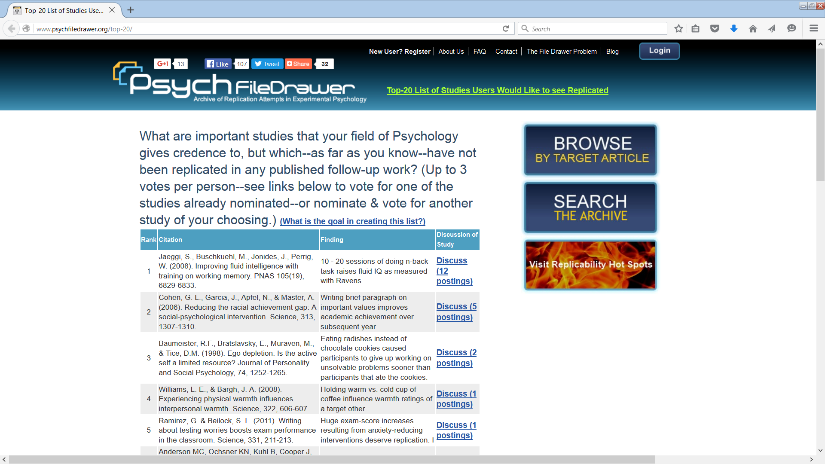
Replication in Psychology

Slide 11
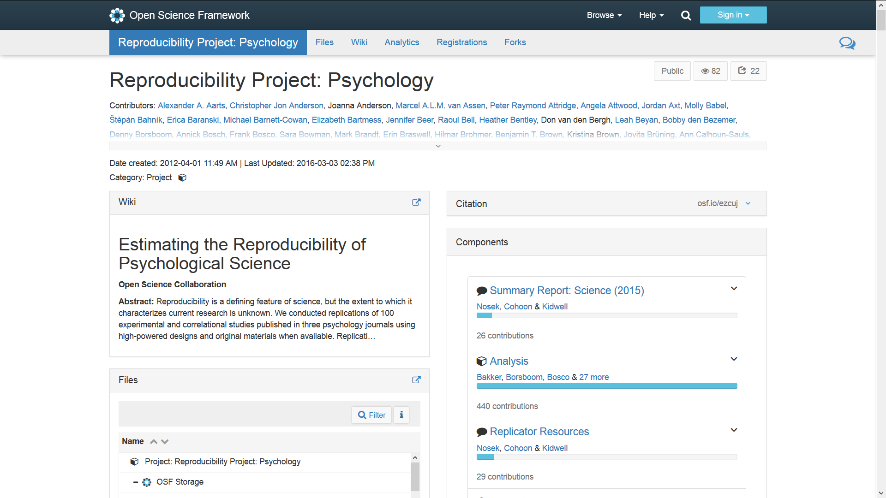
Psychology: Reproducibility project: https://osf.io/ezcuj/

Slide 12
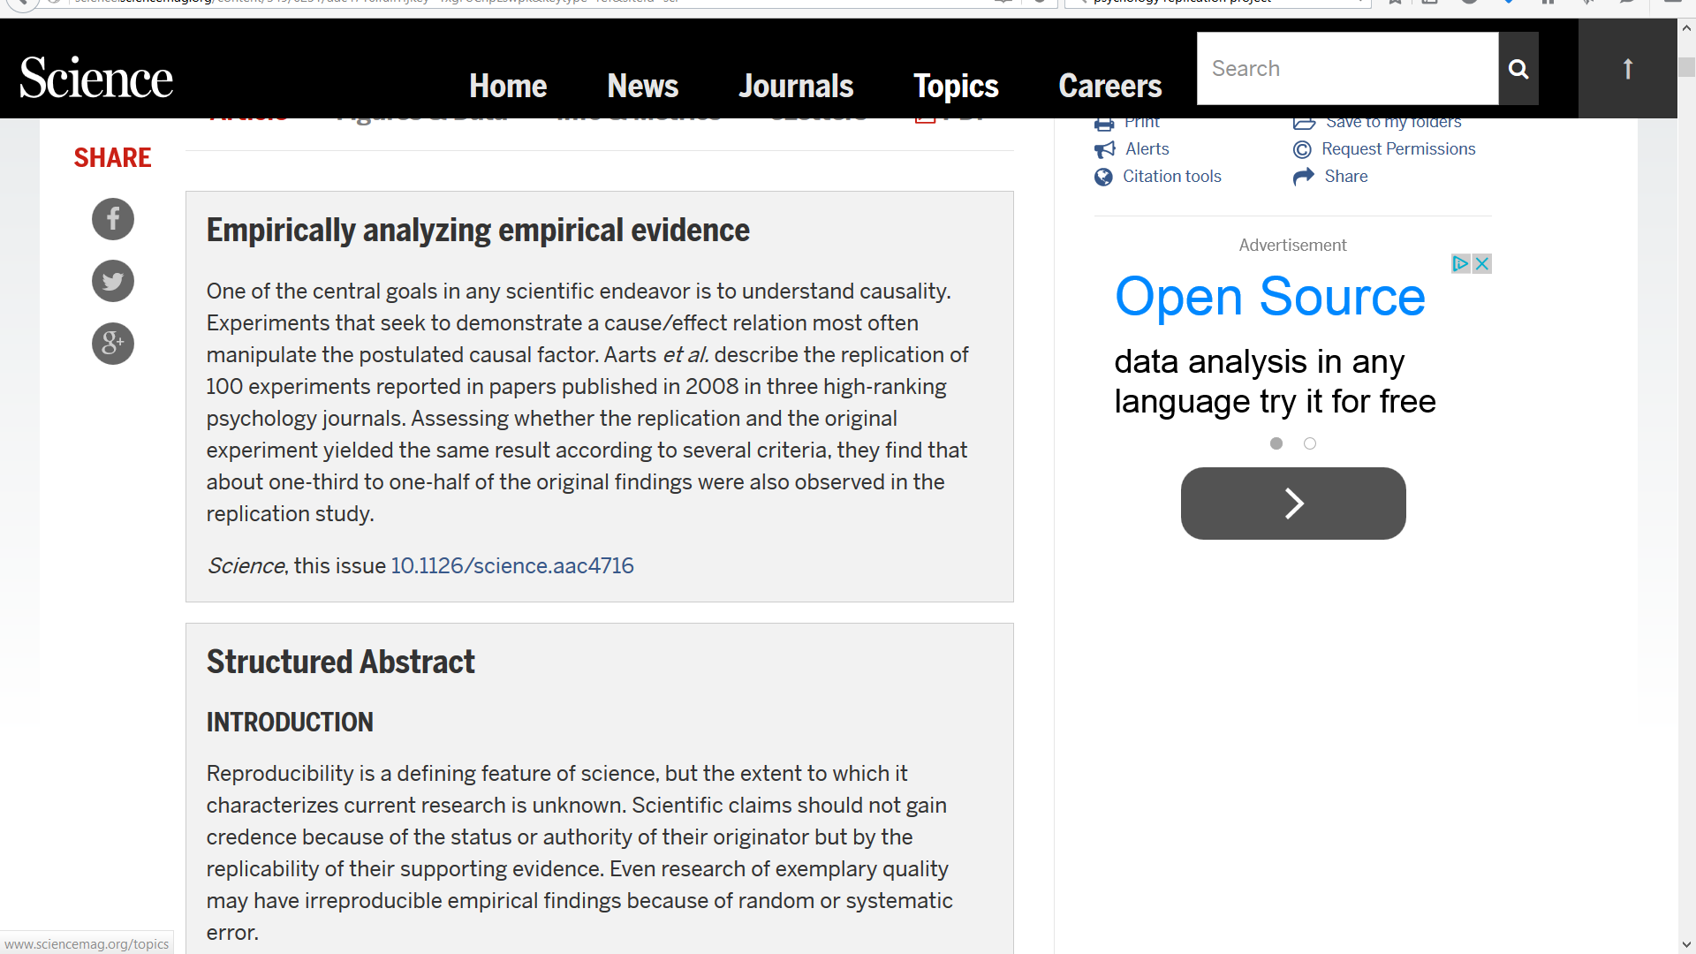
Open Science Collaboration (2015) Science 349.6251

Slide 13
Would linguists replicate?
In most subfields, replication is not rewarded.
  Novelty is rewarded.
“Why would you study that when someone else already did it?”
:Why would we hire you just for showing that evidence for a theory is right?”
We need a change in attitude, particularly in hiring.

Slide 14
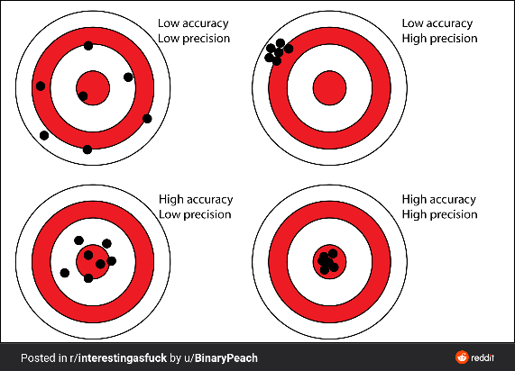
Accuracy & Precision
Suppose your method produces results measured on a continuous scale
  E.g. acceptability/grammaticality judgements, vowel duration, VOT, etc.
Does it hit the target?
“This method is valid and reliable and the results are on average a distance d from the actual datapoint, and inside a range r of those results.
  “Using this method, I know that 96% of my results are on average 10 ms less than actual duration, and all between -20 ms and 5ms.”

Slide 15
Find the stops: 6 different methods
Gold standard: me.
What is the accuracy of the n-undergrad method?
1-undergrad: around 75%
6-undergrad: near 100%
What is the method’s precision?
1-undergrad: 18%
6-undergrad: irrelevant
The 1-undergrad method is around 75% accurate, with a precision of about 18%.
Stops discovered (%) - range
Number of humans

Slide 16
Methods for determining voice/aspiration/stress: VOT
How do phonologists know whether a stop is voiced or voiceless?
  And aspirated vs. unaspirated?
  And “in a stressed or unstressed syllable”?
Answer: Voice Onset Time
  Time between the beginning of the burst and the onset of voicing
How do we measure VOT?
  And what is the accuracy and precision of those measures?

Slide 17
Francis et al (2003): Comparison of VOT methods
Mean asynchrony between the
laryngograph (baseline) and
waveform
F0
F1
F2
F3
measures
The WAV method, with correction,
looks very good!

Slide 18
Precision in the WAV method using undergrads
For stop VOT measured by all 6 humans…
If you want agreement down to 11ms or less, you will find this in 82% of the tokens with 6 human transcribers
Mean of ranges: 8.4ms
Range around the mean of each token:
-4ms to +4.4ms
or -12% to +13%

Slide 19
What now?
The range is ok, but can we improve on accuracy?
For all measurements for a token, take the mean, median, or some weighted measure.
This assumes that a normal distribution (for the mean) is the appropriate model of what the humans are doing
  For the median, it assumes that some humans are inevitably outliers, but the truth is somewhere in the middle
Problem: Not necessarily! It depends on the task
  In this case, people are likely to gravitate towards local landmarks
  Simply put, we’d expect a bimodal or multimodal distribution
    “Conservative” VOT vs. “Liberal” VOT

Slide 20
So how accurate is the WAV method for VOT?
We can’t say precisely because I didn’t compare the results with a laryngograph (‘gold standard’)
But we can report that (for example) [k^{h}] has a range of 34.9-43.6ms VOT
  (not adjusted towards the laryngograph ‘gold standard’)
  If we assume that the actual target is somewhere in that range, then this range is as accurate as we’re going to get with this method

Slide 21
Very small differences
Gordon (2004) on Chickasaw stress
  Duration (measured from the beginning of the vowel to the end “from the waveform in conjunction with a wide band spectrogram)
  Statistically significant differences for different speakers with small differences
  One measurer
  There could be a difference in duration as the realization of a PhM stress distinction
  The measurements are probably within the accuracy range, so it’s possible that there was a tendency to be conservative for one type of measurement, and liberal for another, even unconsciously
 | Primary | Secondary | Unstressed
Male 2 | 104ms | 94ms
Female 3 |  | 85ms | 73ms
Female 5 |  | 75ms | 67ms

Slide 22
Construct Validity
Before even considering reliability, accuracy, and precision, we have to ask:
“Is the method actually about the object we want to study?”
So, what is the object we want to study?
Cognitive module
Standardly:
  L1
  Dominant
  Unimpaired

Slide 23
Properties
Individuality
  Humans do not share brains
L1
  Learned during the critical period
Dominant
  Primary mode of speech in bi/multilinguals
Unimpaired
  No cognitive impairment affecting speech production/perception
  No relevant physical impairment, too

Slide 24
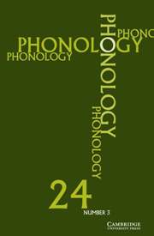
Phonology…
The journal Phonology 1997-2006…
In addition to just data, there’s
information about:
  Number of consultants
  Whether data was pooled or kept separate
  Sex of consultants
  Age of consultants
  Impairment
  Phonetic measurements
Notes:
To help answer this question I decided to look in the journal Phonology – perhaps the most prestigious place for theoretical phonologists to publish in. I looked at all articles between 1997 and 2006 because they’re available online.
In addition to bare data, certain pieces of information were often mentioned: cite list. It’s clear that these things were mentioned because the authors saw them as enhancing the reliability of the data. In some way they contribute to determining what the quality of the data is.
I was also interested in whether people thought that it was essential to collect their own data, so I did some counting, and this is what I found.

Slide 25
Dataset types in Phonology (1997-2006)
103 articles
249 datasets
Notes:
There were 103 research articles (not squibs, not book reviews, not introductions to thematic volumes). I culled 249 distinct datasets. A ‘dataset’ is data that is set out from the text; it can’t have been merely mentioned in passing. Datasets within an article were counted as ‘distinct’ if they were from different languages or consultants, or were about significantly different phenomena. Some articles had lots of data, but only one dataset because they were interested in just one phenomenon from one language.
I found that 56 datasets (22.5%) were sourced from primary data – this is data that the author collected directly from a speaker. 176 were from secondary sources (71%) – this is data from a book or article that reported a primary dataset (eg, grammars, dictionaries). Just two datasets were cited as being from tertiary sources – either a non-native speaker’s judgment, or from a theoretical article that cited a secondary source. I wasn’t able to classify 15 datasets. In these cases, a source wasn’t specified (e.g. citing ‘English’ data without citing whether the source came from a dictionary or from the author); in many of these cases, it seemed that the author spoke the language cited, so was probably using themselves as a source. However, this wasn’t stated outright.
This distribution of dataset type is uninteresting on its own. It’s really irrelevant where the data comes from, from a theoretical point of view. But things get interesting when we delve deeper.

Slide 26
What is being studied?
Pooled behaviour (non-individuals)
It is common – perhaps almost universal – for grammars to be written using several different individuals as sources
It is common for experiments to pool results from many individuals
So, what are these results about?
  Are they about the individual results of an individual?
  No. They are about Frankenstein Modules.

Slide 27
Multiple human sources in Phonology
Pooled | 30 (8.4%)
Not pooled | 15 (4.2%)
Not reported | 314 (87.5%)
Total | 359

Slide 28
What’s the problem?
Braver (2011 et seq) has investigated whether flaps in American English that derive from /t/ are different from those derived from /d/.
Finding:
t-flap: Batter /bæt-əɹ/ -> [bæɾəɹ]
d-flap: Badder /bæd-əɹ/ -> [bæɾəɹ]
“The overall mean duration of vowels preceding /d/-flaps was 8.76ms longer than the mean duration of vowels preceding /t/-flaps (t = −2.105, p < 0.05)”
So, can we assert that there is some PhM and Phonetic Module that generates /d/-flaps that have a preceding vowel duration of 9ms longer than for /t/-flaps?

Slide 29
Braver (2014): Vowel duration before /t/- and /d/- flaps*
My thanks to Aaron for discussing this with me (http://www.aaronbraver.com/papers).
I’m not implying that we agree.

Slide 30
Are they about L1s?
We should be studying speech that is generated by a module that was constructed in the pre-critical period and is dominant
Practical issues:
  Are the subjects native speakers?
  Are they speaking in their vernacular? (Not in an ‘educated’ dialect or style)

Slide 31
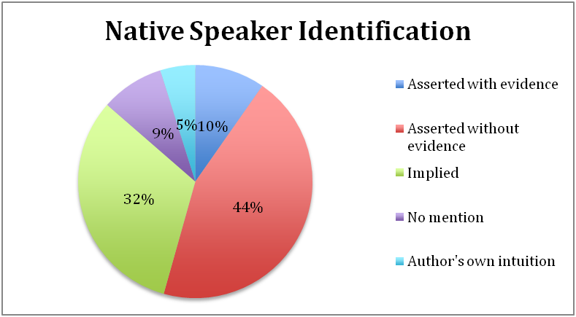
Phonology: Native speaker id/Primary
Fremed (2013); de Lacy (in prep.)
Native speaker identification in Primary datasets in Phonology 1999-2012

Slide 32
Secondary Datasets: L1 reporting.

Slide 33
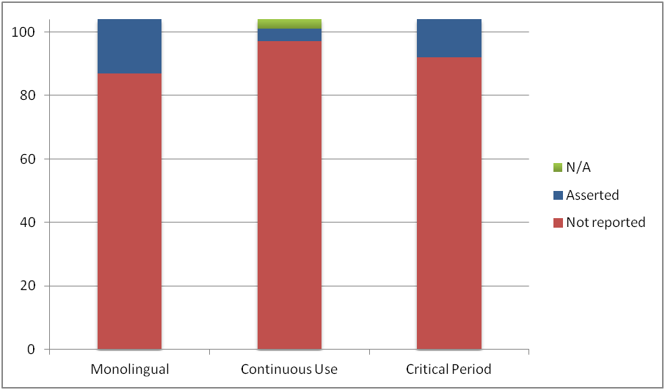
Phonology: 'Native speaker' criteria
Crucial 'native speaker' properties in Phonology for Primary datasets

Slide 34
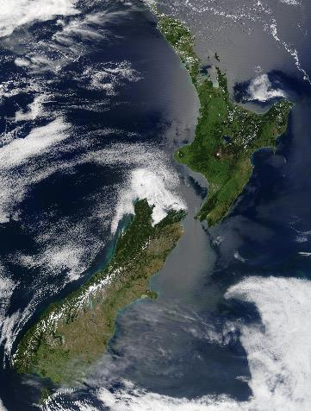
Māori (MAO=[ˈmaːoɾi], NZE=[ˈmæʊɻi])
I worked with speakers.
To determine whether their modules were L1 I asked…
“Did you grow up speaking Māori?”

Slide 35
Responses
 | Yes | No
Dominant L1 | Learned Māori at home during the critical period | Social reasons (views of social inferiority, imperfectness for task, self-labeling as socially inferior) Political reasons (Bowern 2008:143, Crowley 2007:86ff)
L2 or non-dominant L1 | Learned it at school as a subject Learned it at a Kohanga Reo (immersion school) Feels spiritually or culturally Māori; expression of solidarity Comprehends, but does not speak or make grammaticality judgments Magical ideation Mental illness Mendacity for prestige, money | Didn’t learn Māori growing up

Slide 36
Why worry?
Where did the data go?
  de Lacy (2004) “Maximal words and the Māori passive”
  de Lacy (2004) used two methods to gather data:
    Fieldwork methods → uncertainty about native speaker status
    Dictionary-culling methods → ???

Slide 37
de Lacy (2004)’s method combination
Step 1: Gather all verbs and passives from Williams (1971)’s dictionary
Step 2: Verify with native speaker
  The two subjects did not know many of William’s forms
  If the subject didn’t know, they often suggested it was another dialect
    … because Williams’ is sacrosanct
  So: the ‘native speaker verification’ method did not cause any data exclusions!
So, the issue really boils down to:
  Where did Williams’ data come from?

Slide 38
Generative PhM research into the Māori Passive
Biggs 1961;
Pearce 1964;
Hohepa 1967;
Hale 1968, 1973, 1991;
Kiparsky 1971;
Kenstowicz & Kisseberth 1979:171-174;
McCarthy 1981;
Sanders 1990, 1991;
Harlow 1991;
Blevins 1994;
Kibre 1998;
de Lacy 2004.

Slide 39
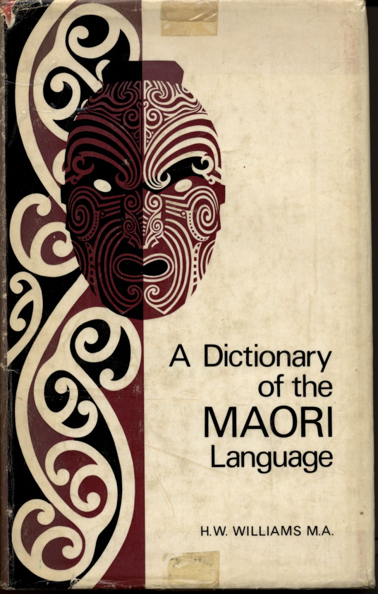
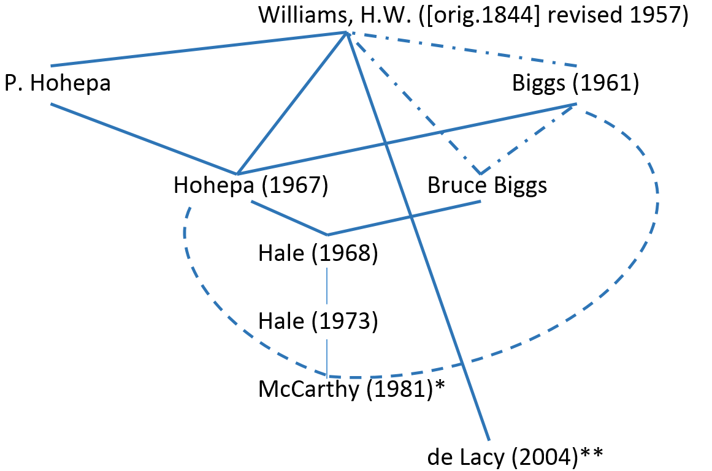
Mapping the passive’s data source
* Not clear if Hohepa & Biggs are data sources
** relies on Williams (1971-7th ed.)

Slide 40
H.W. Tells Us… (1917)
The missionary Kendall (1820)
Dr Maunsell (1850s)
W.L. Williams (1871)
Mr Atkinson (“a master of the language”)
Mr Colenso’s dictionary
Sir George Grey’s collection of Maori books
Mr Elsdon Best
Rev Father Becker, of Hokianga
Mr S. Percy Smith
“In addition to the above, I have received contributions, less in volume, but often of the highest value, from a large number of correspondents, who will, I hope, not measure my gratitude by this very inadequate acknowledgment.”
“My father” (the original Williams)
All Pakeha (i.e. non-Maori of European descent)
Notes:
Thankfully, Herbert Williams, who heavily revised the dictionary in 1917 tells us.
{See the list above.}
It seems that lots of the data came from secondary sources. Therefore, Williams dictionary is a tertiary source.
The data is obviously pooled from many native speakers.
==
Mr Elsdon Best, “whose intimate acquaintance with the Maori, coupled with the scientific method of his enquiries, give to the results of his work a value quite unique. He not only supplied a very large number of words, new meanings, and examples, collected at first hand [PVdeL: from whom? where?], …”
Rev. Father Becker, of Hokianga sent “a large and helpful list of words, collected chiefly in the northern part of the North Island. These words were often of the greatest assistance in elucidating difficulties”
Mr S. Percy Smith.. “contributing lists of words..”
“In addition to the above, I have received contributions, less in volume, but often of the highest value, from a large number of correspondents, who will, I hope, not measure my gratitude by this very inadequate acknowledgment”

Slide 41
William's Preface (5th ed.)
“… and occasionally a Maori may, in all honesty, have been habitually misusing a word in his own tongue.”
“Moreover, local usage in respect of words is frequently very curious and perplexing.”
"In a few cases it has seemed advisable to refer to forms which are undoubtedly misprints."

Slide 42
Uncertainty
McCarthy’s introduction to de Lacy (2004): “[This chapter] proposes an analysis that may be the last word on the problem.“
  Well, the theory (i.e. the analysis) might be right
  But is it a theory of the capabilities of dominant L1 PhMs?
  Can we assert with confidence that some dominant L1 PhM generated the data reported in de Lacy (2004)?

Slide 43
Validity?
What should phonologists do to determine PhM dominant L1ness?
  Strictly speaking, they can do nothing
  There are no valid instruments
A valid instrument
  Informally, some measurement method that has been shown to measure what it’s supposed to measure
Suppose I have a method (‘instrument’)
  #1: Identification of a ‘gold standard’ method of measurement that has a very convincing theoretical justification
  #2: Comparison of the method with the gold standard will tell me whether I should trust the method, and how often, and to what level of accuracy

Slide 44
Gold standards for L1ness?
Suppose our theory says that an L1 PhM is one that is learned during the critical period
Asking “Did you grow up speaking X?” or “Are you a native speaker of X?” seems a poor method given the discussion a moment ago
  because we can think of many situations where a person did not have an appropriate L1 PhM, but still answers “yes”, and situations where they do have an L1 PhM, but answer “no”
Relying on a grammar/dictionary writer is also a bad idea
So what is the gold standard for L1ness?

Slide 45
Problem solved? Li et al (2006, 2013)
Li et al (2006)’s Language history questionnaire and Li et al (2013)’s LHQ 2.0
  Behavior Research Methods 38.2:202-210; Bilingualism 17.3: 673-680
Examined 41 published studies and identified the most commonly asked questions
  Age; how long in L2 country; age started learning L2; self-assessment in reading, speaking, writing, comprehension; language spoken at home.
“… [because the] questionnaire is based on question items that have been used by many researchers in previous studies, a certain degree of validity … can be assumed from the start.” (Li et al 2006:204)
  Assuming a type of construct validity
  However, it is not true that you can take part of two valid instruments, merge them, and still have a valid instrument. You can’t even take part of a valid instrument and assume it is still valid.

Slide 46
Terminology, and Generative goals
Li et al (2006)
Q19: “Estimate, in terms of hours per day, how often you watch TV or listen to radio in your native language and other languages per day”
  What does “native language” mean?
The goal of Li et al (2006, 2013) is (I believe) to propose a valid instrument that can reliably distinguish an individual’s L2 language from their L1 language
  Is “Language” the same as ‘linguistic modules’?
  Is this goal the same as the Generative Phonologist’s goal of determining whether they are eliciting data from a dominant L1 PhM?
  It doesn’t address speech style, so will only eliminate certain L2 PhMs
We need instruments by Generativists for Generativists

Slide 47
What do textbooks say to do?
Bowern (2007), Crowley (2008), Cheliah & de Reuse (2011)
  Give subject desiderata
  But not how to determine these properties
…The ideal consultant is a native speaker of the language under study, and an excellent second-language speaker of the contact language. Ideal consultants have healthy, obliging, and like-minded friends and relatives who don’t mind being asked questions and being roped in work too. They have no speech impediments, they are fluent storytellers, and like thinking about and being creative with language. They have very clear articulation and infinite patience. The ideal consultant has no other demands on their time, they never get sick, and neither do their relatives. They never vary the loudness of their voice….
The ‘ideal consultant’ I’ve just described is a myth.” (Bowern 2007§10.3.1)

Slide 48
Cheliah & de Reuse (2011:168ff)
“8. Linguistically proficient: can produce syntactically well-formed utterances that are semantically meaningful, pragmatically adequate, and textually coherent
9. Language competence: preferably monolingual
10. Linguistic environment: birth place, residence, and working place of the native speaker preferably in language community
11. Linguistic education: native speaker should preferably not be a writer, poet, literary critic, or linguist, but a normal language user
12. Performance abilities: a good communicator but not a professional performer
13. Intuitions: well-working
14. Introspection: does not need to offer grammatical judgments”

Slide 49
The Conservative Approach
Try to determine properties that will ensure (in theory) that the speaker has no option but to speak with an L1 PhM
  Monolingual
  Never left speech community
  Homogenous speech community
  Had no serious contact with another language
Problems
  Still doesn’t solve the problem of speech styles
  This doesn’t force people to speak in their vernacular speech style
  Impractical: Many people are bilinguals, or at least bidialectal; perhaps everyone has more than one speech style
  and it still requires methods for determining whether someone is a monolingual, etc etc.

Slide 50
Grammaticality Judgment method
Idea: Only native speakers can give (consistent, immediate?) grammaticality judgments
Problem: theory-connection: why does it follow that only native speakers can give such judgments?
Some native speakers are not capable of giving judgments
  “I was able to obtain excellent narrative data from the monolinguals, however, I was unable to achieve much with them in the way of ‘traditional elicitation’, in the sense of grammaticality judgements, guided discourse and description tasks, and so on” (Dunn 1999 on Chukchi)
  “The bilinguals tended to be uncomfortable producing novel sentences outside real conversation with other full speakers, and in artificial contexts generally produced very Russian-like syntactic constructions.”

Slide 51
Post hoc evaluation method
Silva (2006) Phonology article
But also Echeverría (1964) on Mapudungan (Araucanian)
  One of his subjects (Maria Catrileo) listened to another subject’s recordings (Ailío)
  She expressed suspicion
  The author found Ailío couldn’t produce some words, and pronounced others inconsistently
Does this tell us about L1ness, or dialect variation, or socio-cultural acceptance?
It’s not practical – we need methods for finding L1 subjects before we do all the work.

Slide 52
Third-person reputation
Dixon (1991) on Mbabaram
“While always friendly, Bennett was at first not the most cooperative of informants, insisting that he remembered very little of the language. As time went by, he became more interested in the project, and more willing (although never eager) to help.” (Dixon 1991:353).
  Was he really an L1 speaker?
  At the very least, he was impaired.
“It became clear that those Aborigines who were recommended to us by the white people were likely to be the least knowledgeable, and least useful for our purposes. The best informants tried to have as little as possible to do with whites, and were often branded by them as troublemakers.” (Dixon 1984:34)

Slide 53
Gold standard: The Fieldworker’s method
Involves getting to know the subject and their community
  Use indirect evidence that the subject grew up speaking the target language exclusively or primarily
  Naturally assess consistency, spontaneity, and so on through elicitation and production tasks
Māori example
  I asked the subject to put a word for a foodstuff in a sentence
  He started crying and recounted how it reminded him of his childhood – his mother used to make this food
Nauru
  After finishing, the subject casually mentioned that she had spoken proper Nauruan to us, and that no-one speaks properly like her
  Argh.

Slide 54
What then?
With a group that has undergone the fieldworker’s ‘extended, organic’ interview, we will end up with a bunch of people and a clear profile of their PhMs and their dominance and L1ness.
With this as the gold standard, we can then test other methods for validity.
It will take a huge amount of time
So, who wants to do this?

Slide 55
Linguistic Methods
Are the methods used arguably about the object of study?
  They should be about dominant unimpaired L1 modules.
  In practice, there is rarely any guarantee that they are.
Are they reliable?
  Some clearly are not
  For most others: Unknown
What is the accuracy and precision of the reliable ones?
  Mostly unknown.

Slide 56
For you
For any method you use to get your evidence, ask:
  Is this evidence really about cognition?
  Is it reliable?
  How accurate and precise is it?
If you are unsure…
  Perhaps you could work on method validity…
  Discuss construct validity…
  Identify a gold standard…
  Determine reliability…
  Determine accuracy and precision!

Slide 57
Why working on methods is a bad idea…
For students:
  You won’t get a job.
For faculty (who care about publishing):
  You’ll find it hard to get published in standard venues.
What we need:
  A wider recognition that there is a problem.
  An acceptance that methods themselves are valid object of study
  A willingness to hire people based on their work on methodology, including replication.

Slide 58
References and Thanks
References are here: http://www.pauldelacy.net/webpage/USC
Thanks to:
  My RAs on the glossolalia project
  Liliana Sánchez for discussion of bilingualism and dominance
  Ariel Fremed for discussions about L1ness, dominance, and attrition
  Shu-hao Shih for his work on Gujarati and sonority-driven stress
  Audiences at Cornell, OCP (Barcelona), Princeton, Harvard, and USC.

Slide 59
A common approach
I looked at 118 grammars (to hand, in my personal library)
  Publication dates range over 100 years; authors are Generative and non-Generative
  There is typically no or little information about L1ness, or about properties that might be used to determine L1ness
Buckley (1994) on Kashaya
Bowern & Lotridge (2002) on Ndebele
Cahill (1999) on Kɔnni
Mosel & Hovdhaugen (1992) on Samoan

Slide 60
Phonology
The journal Phonology
Devoted to phonological theory
1997 to 2006; and 2009 too
122 articles
359 Distinct Datasets
It is difficult to find specific information about methods, consultants, etc.
  13 (of 122) articles have a 'methods' section
Notes:
To help answer this question I decided to look in the journal Phonology – perhaps the most prestigious place for theoretical phonologists to publish in. I looked at all articles between 1997 and 2006 because they’re available online.
In addition to bare data, certain pieces of information were often mentioned: cite list. It’s clear that these things were mentioned because the authors saw them as enhancing the reliability of the data. In some way they contribute to determining what the quality of the data is.
I was also interested in whether people thought that it was essential to collect their own data, so I did some counting, and this is what I found.

Slide 61
Phonology: Native speaker id/Primary
Fremed (2013); de Lacy (in prep.)
Native speaker identification in Primary datasets in Phonology 1999-2012

Slide 62
Phonology: 'Native speaker' criteria
Crucial 'native speaker' properties in Phonology for Primary datasets

Slide 63
There is some validity in Phonology
Côté (2004) Syntagmatic distinctness in consonant deletion
  “the validity of these introspective judgments”
Paster (2004) Vowel height harmony in Buchan Scots
  “the validity of the transcriptions is reinforced by the phonetic analysis to be presented in section 3”
Silva (2006) … emergence of tonal contrast in contemporary Korean”
  “post-hoc efforts to ensure the validity of the speech data”
McCarthy (2003) OT constraints are categorical
  “the following tableaux certify the validity of these ranking arguments”

Slide 64
Validity?
What should phonologists do to determine PhM dominant L1ness?
  Strictly speaking, they can do nothing
  There are no valid instruments
A valid instrument
  Informally, some measurement method that has been shown to measure what it’s supposed to measure
Suppose I have a method (‘instrument’)
  #1: Identification of a ‘gold standard’ method of measurement that has a very convincing theoretical justification
  #2: Comparison of the method with the gold standard will tell me whether I should trust the method, and how often, and to what level of accuracy

Slide 65
Gold standards for L1ness?
Suppose our theory says that an L1 PhM is one that is learned during the critical period
Asking “Did you grow up speaking X?” or “Are you a native speaker of X?” seems a poor method
  because we can think of many situations where a person did not have an appropriate L1 PhM, but still answers “yes”, and situations where they do have an L1 PhM, but answer “no”
So what is the gold standard for L1ness?

Slide 66
Problem solved? Li et al (2006, 2013)
Li et al (2006)’s Language history questionnaire and Li et al (2013)’s LHQ 2.0
  Behavior Research Methods 38.2:202-210; Bilingualism 17.3: 673-680
Examined 41 published studies and identified the most commonly asked questions
  Age; how long in L2 country; age started learning L2; self-assessment in reading, speaking, writing, comprehension; language spoken at home.
“… [because the] questionnaire is based on question items that have been used by many researchers in previous studies, a certain degree of validity … can be assumed from the start.” (Li et al 2006:204)
  Assuming a type of construct validity
  However, it is not true that you can take part of two valid instruments, merge them, and still have a valid instrument. You can’t even take part of a valid instrument and assume it is still valid.

Slide 67
Terminology, and Generative goals
Li et al (2006)
Q19: “Estimate, in terms of hours per day, how often you watch TV or listen to radio in your native language and other languages per day”
  What does “native language” mean?
The goal of Li et al (2006, 2013) is (I believe) to propose a valid instrument that can reliably distinguish an individual’s L2 language from their L1 language
  Is “Language” the same as ‘linguistic modules’?
  Is this goal the same as the Generative Phonologist’s goal of determining whether they are eliciting data from a dominant L1 PhM?
  It doesn’t address speech style, so will only eliminate certain L2 PhMs
We need instruments by Generativists for Generativists

Slide 68
What do textbooks say to do?
Bowern (2007), Crowley (2008), Cheliah & de Reuse (2011)
  Give subject desiderata
  But not how to determine these properties
…The ideal consultant is a native speaker of the language under study, and an excellent second-language speaker of the contact language. Ideal consultants have healthy, obliging, and like-minded friends and relatives who don’t mind being asked questions and being roped in work too. They have no speech impediments, they are fluent storytellers, and like thinking about and being creative with language. They have very clear articulation and infinite patience. The ideal consultant has no other demands on their time, they never get sick, and neither do their relatives. They never vary the loudness of their voice….
The ‘ideal consultant’ I’ve just described is a myth.” (Bowern 2007§10.3.1)

Slide 69
Cheliah & de Reuse (2011:168ff)
“8. Linguistically proficient: can produce syntactically well-formed utterances that are semantically meaningful, pragmatically adequate, and textually coherent
9. Language competence: preferably monolingual
10. Linguistic environment: birth place, residence, and working place of the native speaker preferably in language community
11. Linguistic education: native speaker should preferably not be a writer, poet, literary critic, or linguist, but a normal language user
12. Performance abilities: a good communicator but not a professional performer
13. Intuitions: well-working
14. Introspection: does not need to offer grammatical judgments”

Slide 70
The Conservative Approach
Try to determine properties that will ensure (in theory) that the speaker has no option but to speak with an L1 PhM
  Monolingual
  Never left speech community
  Homogenous speech community
  Had no serious contact with another language
Problems
  Still doesn’t solve the problem of speech styles
  This doesn’t force people to speak in their vernacular speech style
  Impractical: Many people are bilinguals, or at least bidialectal; perhaps everyone has more than one speech style
  and it still requires methods for determining whether someone is a monolingual, etc etc.

Slide 71
Grammaticality Judgment method
Idea: Only native speakers can give (consistent, immediate?) grammaticality judgments
Problem: theory-connection: why does it follow that only native speakers can give such judgments?
Some native speakers are not capable of giving judgments
  “I was able to obtain excellent narrative data from the monolinguals, however, I was unable to achieve much with them in the way of ‘traditional elicitation’, in the sense of grammaticality judgements, guided discourse and description tasks, and so on” (Dunn 1999 on Chukchi)
  “The bilinguals tended to be uncomfortable producing novel sentences outside real conversation with other full speakers, and in artificial contexts generally produced very Russian-like syntactic constructions.”

Slide 72
Post hoc evaluation method
Silva (2006) Phonology article
But also Echeverría (1964) on Mapudungan (Araucanian)
  One of his subjects (Maria Catrileo) listened to another subject’s recordings (Ailío)
  She expressed suspicion
  The author found Ailío couldn’t produce some words, and pronounced others inconsistently
Does this tell us about L1ness, or dialect variation, or socio-cultural acceptance?
It’s not practical – we need methods for finding L1 subjects before we do all the work.

Slide 73
Third-person reputation
Dixon (1991) on Mbabaram
“While always friendly, Bennett was at first not the most cooperative of informants, insisting that he remembered very little of the language. As time went by, he became more interested in the project, and more willing (although never eager) to help.” (Dixon 1991:353).
  Was he really an L1 speaker?
  At the very least, he was impaired.
“It became clear that those Aborigines who were recommended to us by the white people were likely to be the least knowledgeable, and least useful for our purposes. The best informants tried to have as little as possible to do with whites, and were often branded by them as troublemakers.” (Dixon 1984:34)

Slide 74
Gold standard: The Fieldworker’s method
Involves getting to know the subject and their community
  Use indirect evidence that the subject grew up speaking the target language exclusively or primarily
  Naturally assess consistency, spontaneity, and so on through elicitation and production tasks
Māori example
  I asked the subject to put a word for a foodstuff in a sentence
  He started crying and recounted how it reminded him of his childhood – his mother used to make this food
Nauru
  After finishing, the subject casually mentioned that she had spoken proper Nauruan to us, and that no-one speaks properly like her
  Argh.

Slide 75
What then?
With a group that has undergone the fieldworker’s ‘extended, organic’ interview, we will end up with a bunch of people and a clear profile of their PhMs and their dominance and L1ness.
With this as the gold standard, we can then test other methods for validity.
It will take a huge amount of time
So, who wants to do this?

Slide 76
Dominance: Methods
Advanced research into validity of methods for determining dominance
  Flege et al (2003), Cutler et al (1989, 1992), Lim et al (2008), Dunn & Foxtree (2009), Golato (2002), Bedore et al (2012), Gollan et al (2012)
Self-ratings of ability to read, speak, write, understand
  Assumes reading/writing is possible in L1, and subject is educated
Subjective judgment of a bilingual experimenter
  Assumes subject-experimenter speech homogeneity]
vocabulary tests (single word repetitive…)
  Assumes that we know something about the language]
language history tests
ability to make word-order judgments
speed/fluency/automaticity
“If you had to lose one of your languages to save your life, which would you keep?” (Cutler et al 1989)
Sentence durations
Percentage of each language used

Slide 77
Issues with dominance instruments
Issue 1: The terms “bilingual”, “dominance”, “L1”, and “L2” are not necessarily the same as the Generative concepts
  ‘L1’ and ‘L2’ and ‘dominance’ seem to be labels of performance capabilities rather than modular properties
  “A measure of bilingual dominance can only be validated by demonstrating its ability to predict performance in in the L1 and L2” (Flege et al 2002:571)
Issue 2: What is the gold standard? And why? (What is its theory connection?)
Overall issue
  Not designed to test properties defined in Generative phonology – Competence properties; instead they measure performance properties
  We need methods by Generativists, for Generativists.

Slide 78
Impairment: Many valid instruments here
Some instruments of interest to phonologists …
Circadian Rhythm (Tiredness): Guthrie et al 1995 and refs cit.
Acute alcohol intoxication: BAC tests, SFST sobriety tests
Potential for chronic inebriation: MAST and its successors (Sezer 1971)
Acute and chronic physical impairment: physical inspections (eye tests, color-blindness tests, hearing tests)
Acute psychological impairment tests: more difficult
Chronic psychological impairment tests: a variety of instruments, including magical ideation
However, the most common impairment is atrophy/attrition, and we don’t have a valid questionnaire for it.

Slide 79
Related fields
Speech Pathology: many validated methods (though perhaps often not appropriate in the Generative context)
Phonetics
  Determining place of articulation
  Blumstein & Stevens (1979-JASA 66), Stevens & Blumstein (1981)
    Using LPC spectra for the first 25ms of CV sequences…
    85% accuracy for 1,800 tokens produced by four male and two female speakers
  Lahiri et al (1984)
    Using change in distribution of high-frequency energy vs. low-frequency energy between C’s burst release to onset of voiced formant transition
    91% of labial, dental, and alveolar plosives in three languages were correctly classified

Slide 80
A lot of trouble to go to?
What evidence is there that the data we (phonologists) have been relying on is not from unimpaired dominant L1s?
Suppose I claim that all the data is from impaired L2s. Prove me wrong.
  Reliance on grammars
  Grammars are about formal speech styles
    Are formal speech styles L1? Are they dominant?
    e.g. Zuraw et al (2014) on Samoan: specifically mention both vernacular and formal speech styles, but choose to go for the formal speech style
      Because it “preserves more segmental contrasts”
      Also the grammars and dictionaries are in the formal speech style
      The formal and vernacular segment inventories are quite different
  Grammars are about normative speech (or have some other goal)

Slide 81
Skorik’s Chukchi: L1 or something else?
“Further identification and full description of Chukchi dialects is an urgent task, but can only be possible if there is a detailed systematic phonetic and grammatical description of the literary Chukchi language, which is based on the Eastern dialect. The present work is a part of such a description.” (Skorik 1961:13) [my translation]
“Schoolteachers, who had all attended the same teachers’ college in St Petersburg, had received heavy exposure to Skorik’s Chukchi grammar, and accepted it as the prestige standard, although admitting privately that nobody they knew spoke like that. People are quite happy to conclude that all Chukchi speakers use their native language incorrectly if popular usage does not agree with Skorik’s grammar.” (Dunn 1999)
“Unless evidence is forthcoming that Skorik’s data represents a true, spoken variety [of] Chukchi it would be wise to approach his materials with skepticism.” (Dunn 1999)

Slide 82
Asking doesn’t guarantee validity
Responses to questions can be affected by:
Memory and attention
Magical Ideation
  Asking some who has high magical ideation which hand they use makes them more prone to answer that they are ambidextrous (Badzakova-Trajkov et al. 2011:2902)
Cognitive Impairment
Mendacity
Mode of questioning
  Adult respondents with more than a high-school education reported more mental health symptoms using the computer (Epstein et al 2001)

Slide 83
Why asking isn’t enough #1: Memory & Attention
People forget which languages, dialects, and speech styles, they encountered as children
  Example of xenoglossia
People make mistakes – they check the wrong box
  For any questionnaire, what are the chances that people will answer a question wrong?
  How long is the questionnaire?

Slide 84
Why isn’t asking people enough #2: Magical ideation
Magical ideation: “belief in forms of causation that by convention are invalid” (Eckblad & Chapman 1983)
Correlation: high magical ideation scores ~ smaller degree of hand preference
  ‘ambidextrousness’
Question-taking behavior makes people who score higher on magical ideation more prone to the idea that they can use their non-dominant hand
  (Badzakova-Trajkov et al. 2011:2902)
To what extent does magical ideation affect a subject’s claims about L1ness?

Slide 85
Why isn’t asking people enough #3: Cognitive impairment
To what extent does depression, schizophrenia, etc. affect a subject’s claims about L1ness?
Reporting of mixed-handedness is higher in those who are more prone to psychosis
  i.e. score highly on the Peters et al. Delusions Inventory (Preti et al. 2007)
Anxiety and psychological distress might affect articulation, judgments, etc.
Question from the K6 instrument (Kessler et al. 2003).
D3. About how often during the past 30 days did you feel …?
(a) Nervous?
(b) Hopeless?
(c) Restless or fidgety?
(d) So depressed that nothing could cheer you up?
(e) That everything was an effort?
(f) Worthless?

Slide 86
Why isn’t asking people enough #4: Mendacity
There are tiny numbers of people with chronic mendacity (Grubin 2005)
  Though might be higher in some specific populations (King & Ford 1999)
“There is an odd coda to the Mbabaram story. In 1977 the Australian Institute of Aboriginal Studies brought to Canberra for two days an Aborigine who called himself Alec Chalk (or Col Stephens) and purported to speak Mbabaram. Of the 200 or so words he gave, about 20 are recognisable as Mbabaram (they are mostly kin terms); the remainder are largely Warungu,with a few from Wagaman-Jangun-Muluriji. A transcription of this material (by Michael Walsh) was filed by AIAS under the name ‘Mbabaram’.” (Dixon 1991:353)

Slide 87
Why isn’t asking people enough #4: Mode of questioning
Interviewer+paper+pencil vs. on a computer screen (Epstein et al 2001)
Adult respondents with more than a high-school education reported more mental health symptoms using the computer
  Similar results for other sensitive topics
Perhaps relates to familiarity with computers, but could also be due to the perception that in the paper & pencil test the interviewer saw their answers
  Or perhaps the computer method gave people more freedom to lie or elaborate

Slide 88
Validity in PhM-internal methods
Validity is also relevant for entirely PhM-internal methods
Example: Determining OT rankings from data
Typical scenario: you are given some data and told to figure out the ranking for it
  Actually you are asked to figure out all possible rankings
  The expected answer is a partial order of constraints that covers all possible total orders that generate the data
How?

Slide 89
2x2 Violation Tableaux Method
 |  | C1 | C2
☹ | A |  | *
 | B | *!
McCarthy (2002) “A ranking argument uses two candidates to rank two constraints”
McCarthy (2008) Doing OT: “2x2 tableaux … [were] the normal form of ranking arguments at the time [PdeL: in 1993, but really up to 2002]”
Is this method of discovering the ranking valid?

Slide 90
McCarthy (2002) on 2x2’s validity
“the dicta here [how to figure out a ranking] are not assumptions or deductions but rules of thumb derived from experience.”
We could test the validity by listing all possible rankings (possible for a finite CON)
  And identifying for each ranking all minimal sets of data that would uniquely lead to that ranking
  Might be difficult!
  Then test the 2x2 method to see if it can go from all data sets to all rankings
However, we’d also need to include partial orders
  The 2x2 method is supposed to also identify all partial rankings
  A dataset often (usually! almost always!) doesn’t converge on one ranking, but several – i.e. a partial order
  So we’d have to do the same for all possible partial orders

Slide 91
Is the 2x2 method valid?
An alternative approach to validity
  Abstract away from particular data and rankings
Prince (2002) Arguing Optimality (and other Prince papers on Comparative tableaux)
  2x2 method fails to get disjunctive partial rankings
  (C₁ ∨ C₂) » C₃
  i.e. the data can be accounted for by any of:
    C₁ » C₃ » C₂
    C₂ » C₃ » C₁
    C₁ » C₂ » C₃
    C₂ » C₁ » C₃

Slide 92
An example
/tapata/ → [tapat] (apocope)
/tapa/ → [tapa] (blocking!)
/tapa/ → [tapa] (blocking again!)
 | /tapata/ | *V# | max
☞ | tapat |  | *
 | tapata | *!
*complex FTBIN
*V#
MAX
 | /tapta/ | *complex | *V#
☞ | tapta |  | *
 | tapt | *!
*complex or FTBIN
*V#
MAX
 | /tapa/ | FtBin | *V#
☞ | tapta |  | *
 | tapt | *!

Slide 93
More on this…
McCarthy (2008) Doing OT: sections 2.2.5, 2.5, 3.3
What’s the right method?
A different kind of tableau (Comparative tableaux)
A monster tableau (all members of CON at once, in theory)
  By the way – a terrible method of argument presentation, but demonstrably more valid than the 2x2 method
  Can do everything the 2x2 method can do, and nothing it can’t.
The punchline:
  We even need to ask about validity of methods that seem very ‘abstract’

Slide 94
Thinking Bigger: AM vs GM
Two methods for evidence gathering (let’s focus on stress)
  Grammar/Impressionistic method (GM): Cull data from a grammar/dictionary that was compiled using impressionistic methods
  Acoustic method (AM): measuring acoustic properties (experiment+acoustic analysis+interpretation)
    Gordon (2004) on Chickasaw, Gordon & Applebaum (2010) Turkish Kabardian, Gordon & Nafi (2012) Tashlhiyt Berber, Garellek & White (2012) Tongan, Tabain et al (2014) Pitjantjatjara, Shih (in progress) Gujarati, Haghverdi (in progress) Armenian, Bowern et al (to appear) Yidiny
What is the gold standard? AM or GM?
  No need to determine: we can consider their consistency: do they agree with each other?

Slide 95
AM-GM mismatches
Yidiny (Bowern et al to appear)
  Famous as ‘switch language’ (e.g. Houghton 2013)
  Dixon (1977)’s grammar: stress 2nd syllable if long, else initial syllable
  Bowern: main stress is always initial (from duration and pitch)
Tongan (Garellek & White 2012)
  Famous as showing “top-down constructionism” (e.g. Prince & Smolensky 1993/2004)
  Churchward: Stress the penultimate mora, disregarding syllable boundaries ([maáma])
  G&W: The penultimate mora could be stressed, but it’s equally possible that there is a H tone there
Gordon (2014): ‘final stress’ is often a phrase-final phrase-level tone

Slide 96
What now?
We need information on validity, reliability, and accuracy for each method
Evaluation
  To what extent should we trust this particular method that we use?
  We can check internal consistency easily (reliability)
  We can determine accuracy for many methods too (perhaps harder)
Gold standards
  Identifying gold standards,
  and using as a basis for calculating validity

Slide 97
References and Thanks
References are here: http://www.pauldelacy.net/webpage/USC
Thanks to:
  My RAs on the glossolalia project
  Liliana Sanchez for discussion of bilingualism and dominance
  Ariel Fremed for discussions about L1ness, dominance, and attrition
  Audiences at Cornell, OCP (Barcelona), Princeton, and Harvard.

