Slide 1
The inadequacy of evidence for sonority-driven stress
LSA Linguistic Institute, July 12 2013
Paul de Lacy
Rutgers University
http://www.pauldelacy.net
delacy@rutgers.edu
Workshop on
Universality and Variability in
Segment-Prosody Interactions
Notes:
TALK: 30 mins + 10 mins questions

Slide 2
Workshop Goals
To gain more insight into the interdependence of the segmental and prosodic levels from a cross-linguistic perspective
What patterns of segmental and supra-segmental interactions are found cross-linguistically?
How does metrical structure influence segments, phonotactics, and phonological processes?

Slide 3
Sonority-driven stress in Chukchi
Stress the rightmost syllable of the root
winrét-əkə ‘help-3sg’
jará-ŋə ‘house-abs sg’
reqoká-lgən ‘sand’
But avoid stressing a schwa
pátgərg-ən ‘hole’
rócgəp-ək ‘enervate’
And avoid high vowels [i u] when more sonorous vowels [e o a] are available
wéni-wen ‘bell’
céri-cer ‘dirt’
kéli-kel 'paper'

Slide 4
Sonority-driven stress leads to …
How does metrical structure influence segments, phonotactics, and phonological processes?
How do segments influence metrical structure?

Slide 5
What we know
19 years of work on sonority-driven stress
Kenstowicz (1994/1997) (ROA 33)
de Lacy (2002, 2004, 2006, 2007)
McGarrity (2003)
Crowhurst & Michael (2005)

Slide 6
Claims made
Sonority can be a factor in influencing metrical structure – both foot heads and non-heads
Cannot be reduced to moraic content
a > e/o > i/u > ə > ɨ
Language-specific category collapse is possible
It's ubiquitous

Slide 7
Is it all about schwa?
Some cases are avoidance of stressed schwa
  Alyutor, Indonesian, Karo Batak, Yil, Yimas
Others avoid stressed ɨ, or both ɨ and ə
  Pichis Asheninca, Kobon; Au, Nganasan
Others involve multiple levels of avoidance
  Kara, Kobon a > others
  Gujarati a > e/o/i/u > ə
  Komi, Moksha a/e/o > i/y/u > ə
  Lushootseed a > i/u > ə
  Nganasan a/e/o > i/y/u/ə/ ɨ
  Takia a > e/o > i/u

Slide 8

Throughout the world … (~ 25 cases)

Slide 9
Evidence and Theory
Given a theoretical statement T, what is evidence for T?
What is the theory?
Generative Phonology
  (Chomsky & Halle 1968 and others since then)
What does Generative Phonology say is evidence for it?

Slide 10
Why studying the PhM is difficult
Other cognitive influences (e.g. memory, attention)
Lexicon
Syntax
Morphology
Phonological Module
Phonetic Module
Neuro-motor interface
Articulators
Transmission medium
Hearing apparatus
Auditory-neural interface
Other cognitive influences (e.g. memory, attention)
(Perceptual) Phonetic Module
Phonological Module
Representation of perceived sound

Slide 11
Chukchi

Slide 12
Chukchi
One of the first cases of sonority-driven stress discussed: Kenstowicz (1994/1997)
Multiple sonority levels are active:
  Perhaps: a > e,o > i,u > ə
  But argued to be at least: a, e, o > i,u > ə
One of the best documented cases:
  Bogoras (1922), Skorik (1961, 1983), Krause (1979), Volodin & Skorik (1997), Dunn (1999)

Slide 13
Kenstowicz (1994/1997)'s Chukchi
Default stress
  Rightmost root syllable
  winrét-əkə ‘help-3sg’
  jará-ŋə ‘house-abs sg’
  reqoká-lgən ‘sand’
    But not word-final
tití-ŋə cf títi-t ‘needle’
wárat cf warát-te ‘people’

Slide 14
Kenstowicz' Chukchi: Schwa avoidance
Avoid stressing a schwa
pátgərg-ən ‘hole’
rócgəp-ək ‘enervate’
Even if it means stressing the word-final syllable
ətlá ‘mother’
ləlé-t eyes

Slide 15
Kenstowicz' Chukchi: í/ú avoidance
Expected penultimate stress:
  nuténut ‘land’
  piŋépiŋ ‘snowfall’
  jilʔé-jil 'squirrel'
But antepenult when the penult is i/u and antepenult is e/o (and a?)
wéni-wen ‘bell’
céri-cer ‘dirt’
kéli-kel paper

Slide 16
Analytically
Avoid stressed schwa
Avoid PrWd-final stress
Avoid stressed high vowels
Align the PrWd head with the rightmost root syllable
*Hd/ə » nonfinality » *Hd/{ə,i,u} » align-R(Root,'σ)

Slide 17
Well-sourced
Bogoras/Boas (1922)
Skorik (1961)
Krause (1979)
Skorik (1983)
Volodin & Skorik (1996)
Kenstowicz (1994/1997)
Dunn (1999)

Slide 18
What is the object of study?
Generative phonology
  is about an object in the natural world: the Phonological Module (PhM)
If E is evidence for the PhM, then some PhM in the world generates E
What else could speech data be about?
Behavior ~ normative behavior
  'A language'
Was the Chukchi data above generated by a PhM that exists (or did exist)?

Slide 19
Skorik (1961)
“Further identification of the Chukchi language’s dialects and a full description of them is an urgent task, but this will only be possible if there is a detailed description of the phonetics and grammar of the literary language, which is based on the eastern dialect. The present work is such a description.” (Skorik 1961:13; my translation)

Slide 20
Dunn (1999) on Skorik
“Schoolteachers, who had all attended the same teachers’ college in St Petersburg, had received heavy exposure to Skorik’s Chukchi grammar, and accepted it as the prestige standard, although admitting privately that nobody they knew spoke like that… People are quite happy to conclude that all Chukchi speakers use their native language incorrectly if popular usage does not agree with Skorik’s grammar. While methodologically suspect, the greatest tragedy of this is that it frequently renders language teaching to non- and partial speakers completely ineffective—the language they are taught does not correspond to that used in the community.” (Dunn 1999:16)

Slide 21
Dunn (1999:1)
"This 'standard language' is an artificial language based on conservative northern Chukchi, and which underwent various forms of engineering during the Soviet period.”
"Although the grammar includes copious numbers of example sentences, their naturalness as examples of Chukchi is questionable. … suggesting strongly that they are either all translations of Russian, or worse, that they are simply made up … Unless evidence is forthcoming that Skorik’s data represents a true, spoken variety [of] Chukchi it would be wise to approach his materials with skepticism.” (Dunn 1999)

Slide 22
Is Skorik (1961) unusual?
Large studies of phonological stress use grammars
  Hayes (1995), Gordon (1999)
Gordon’s (1999: appendix 1) list of 392 stress systems
  mean publication date for earliest sources is 1972 and the median is 1975, so Skorik is slightly older than the average, but not too far
Goals of grammar-writers
  To create a statement of normative behavior
  For religious, political, commercial, or other reasons ("it's a job", "save the languages")
How many descriptions aim to describe the capabilities of a PhM?

Slide 23
Dunn (1999)
“this is the first attempt at a comprehensive grammar of Chukchi which [is] … based on unelicited spoken language produced by near monolinguals.” (Dunn 1999:1)
But still about normative behavior
  Amalgamated the speech of many people
  Produced a synthesis that he called 'the Chukchi (Telqep dialect) language'
  What happened when people disagreed? Democracy?
  If 10 people said [ətlá] ‘mother’ and 4 said [ə́tla], which one is the Chukchi form? Which one made it into the grammar?

Slide 24
Suppose …
'Chukchi' speakers | Stress where? | Avoid schwa? | Avoid final stress?
Kromo | Penult | Yes | No
Təwiwi | Penult | No | Yes
Rərowtat | Antepenult | Yes | Yes
Democracy:
"Chukchi" stresses the penult, avoids schwa, and avoids final stress
But there is no PhM that generates this pattern
  Perhaps this pattern is impossible

Slide 25
PhM or person?
Multilinguals have several PhMs
  Speech must be controlled for PhM
“Full speakers [of Chukchi] generally keep the two languages apart, but in certain circumstances speakers switch between Chukchi and Russian within a single sentence.” (Dunn 1999:14)
“In Tawajwaam the language of day-to-day communication is Russian. People of about 30 years and older speaker Chukchi, and the elderly are monolingual. The bilinguals use a certain amount of code-switching” (p.16).

Slide 26
Speech Style
Everyone(?) has multiple speech styles
“This work focuses on a subset of speech genres … (i) conversation, (ii) elicited monologues, and (iii) folktales.” (p.17-18).
“The examples of conversation were limited to incidental conversation and semi-interview situations with one (younger, usually less fluent) native speaker talking with a knowledgable older speaker about a topic selected by me and the interviewer.”

Slide 27
Eliciting my data
 | butter | metre | hospital
Informal | bʌɾə | míːɾə | hɔspəɾəʊ
Acrolect | bʌɾə | míːtə | hɔspətɫ
Elicitation possibilities, no control for speech style
{míːɾə, hɔspəɾəʊ} = PhM
{míːɾə, hɔspətɫ} = Not a PhM
{míːtə, hɔspəɾəʊ} = Not a PhM
{míːtə, hɔspətɫ} = PhM
Q: In the journal Phonology, how many articles state that they controlled for
speech style, and explained how they did it?
A: I found one: Broselow et al. (1997)

Slide 28
Meadow Mari pooling
Stress the rightmost non-schwa, avoiding word-final e/o/ø too; else the leftmost syllable
  Co.'Co
  'Co.Cə
  'Co.Ce
  'Cə.Ce
  'Cə.Cə
Lehiste et al. (2005)'s phonetic study identified vowel duration as marking stress
  They then checked to see if their subjects' duration matched the traditional stress descriptions

Slide 29
Actual PhMs ≠ "Mari"
 | LV | ST | VN | VA | EI | AA | NK | JT | Pooled
šəŋa | 1 | 2 | 2 | 2 | 2 | 2 | 2 | 2 | 2
kəne | 1 | 1 | 1 | 1 | 2 | 2 | 2 | 2 | 1/2
čəke | 1 | 1 | 2 | 1 | 2 | 2 | 2 | 1 | 1/2
kəša | 1 | 2 | 2 | 2 | 2 | 2 | 2 | 2 | 2
kugu | 1 | 2 | 1 | 2 | 2 | 2 | 2 | 2 | 2
ida | 1 | 2 | 2 | 2 | 2 | 2 | 2 | 2 | 2
vita | 1 | 2 | 1 | 1 | 2 | 2 | 2 | 2 | 2
šunna | 1 | 1 | 1 | 2 | 2 | 1 | 2 | 1 | 1
ijda | 1 | 2 | 1 | 1 | 2 | 2 | 2 | 2 | 2
purde | 1 | 2 | 2 | 1 | 2 | 2 | 2 | 2 | 2
kidda | 1 | 2 | 1 | 2 | 2 | 2 | 2 | 2 | 2
pörtda | 1 | 2 | 1 | 2 | 2 | 2 | 2 | 2 | 2
akla | 1 | 2 | 1 | 2 | 2 | 2 | 2 | 2 | 2
ludde | 1 | 2 | 2 | 2 | 2 | 2 | 2 | 2 | 2
luaš | 2 | 2 | 1 | 2 | 2 | 2 | 2 | 2 | 2
jereš | 2 | 1 | 2 | 2 | 2 | 2 | 2 | 2 | 2
Is there a PhM that generates "Mari" stress?

Slide 30
And which PhM are you using now?
For perception, the situation is much trickier
When we ask "Is this form acceptable to you?" which PhM is being used?
van Zanten et al. (2004) in a perceptual experiment about Indonesian stress (which avoids stressed schwa):
  “We presented the listeners with a great variety of pitch movements as regards shapes and locations. All these stimuli were acceptable to the listeners. One listener actually remarked that he could hear that the stimuli were different, but that he, as an Indonesian, was used to different pronunciations, and that all stimuli were quite acceptable to him.” (p.10)

Slide 31
Lexicon vs. PhM: stress source ambiguity
Other cognitive influences (e.g. memory, attention)
Lexicon
Syntax
Morphology
Phonological Module
Phonetic Module
Neuro-motor interface
Articulators
Transmission medium
Hearing apparatus
Auditory-neural interface
Other cognitive influences (e.g. memory, attention)
(Perceptual) Phonetic Module
Phonological Module
Representation of perceived sound

Slide 32
Lexicon vs. PhM
Is [nuténut] stressed on the penult because
  Lexicon: /nuténut/ → [nuténut]
  or PhM: /nutenut/ → Transformation: [nuténut]
Stress avoids high vowels for mid vowels …
wéni-wen ‘bell’
céri-cer ‘dirt’
kéli-kel 'paper'
nuténut ‘land’
  piŋépiŋ ‘snowfall’
  jilʔé-jil 'squirrel'

Slide 33
Are three forms enough?
wéni-wen ‘bell’
céri-cer ‘dirt’
kéli-kel 'paper'
nuténut ‘land’
  piŋépiŋ ‘snowfall’
  jilʔé-jil 'squirrel'
nútenut
{no form}
jílʔe-jil
mére-mer ‘tears’
Bogoras (1922)

Slide 34
Sensitivity to schwa?
ətlá "mother"
Krause (1979:127)
  /ətlaʔ/ → [ətlá] cf [ətlaʔ-t] (plural)
  /wəlpa/ → [wə́lpə] cf. [wəlpá-t] (plural)
So: /ətláʔ/ → [ətlá]
    /wə́lpə/ → [wə́lpə]
“As such, the proposed rule of stressed schwa retraction [i.e. avoidance of stressed schwa] may prove to be trivial in the derivations of forms such as [tátlən-ək], because the surface stress could have been as easily underlyingly assigned as retracted.” (Krause 1979:127)

Slide 35
Krause (1979) comments
“Problems such as this pervade any investigation of stress without a native informant” (p.124)
“[because of using written materials only] certain phonological phenomena such as potentially stress related topics did suffer (due to the scarcity of accentual marks) and must be left to future investigation.”
Loanwords: ziráf ‘giraffe’, četwérɣ ‘Thursday’

Slide 36
Lexicon Summary
Generative Phonological theories allow stress to be specified in the lexicon, and to be assigned by the PhM
There is an ambiguity of source
Therefore, techniques of disambiguation must be applied
Apparently not done adequately for 'Chukchi'

Slide 37
PhM vs. Post-PhM: stress ambiguity
Other cognitive influences (e.g. memory, attention)
Lexicon
Syntax
Morphology
Phonological Module
Phonetic Module
Neuro-motor interface
Articulators
Transmission medium
Hearing apparatus
Auditory-neural interface
Other cognitive influences (e.g. memory, attention)
(Perceptual) Phonetic Module
Phonological Module
Representation of perceived sound

Slide 38
The PhM itself
[ətlá] ‘mother’
  asserts something about perceived speech:
  That the hearer perceives some prominence on the second syllable
  Where did the prominence come from?
    The speaker's PhM?
    The speaker's Phonetic module?
    The speaker's articulators?
    The hearer's perceptual system?
The model predicts multiple sources of ambiguity

Slide 39
Technique for disambiguation
“segmental rules, intonational patterns, and phonotactic constraints agree with each other in diagnosing a particular stress pattern.”
  (Hayes 1995:9)
Are there PhM processes that diagnose stress in Chukchi?
  No apparent stress-conditioned allophony
Vowel reduction?

Slide 40
VR in Chukchi (?)
Root /e a/ → [ə] if word-final
  /umqe/ → [umqə] cf [umqe-t] (plural)
  /ətlaʔ/ → [ətla] ‘mother’, *[ətlə]; cf [ətlʔat] (plural)
Protection by a metrical head: Therefore, heads avoid schwa
Problem #1: Dunn (1990:107)
  In describing this process, gives [ətlə]
Problem #2: Skorik (1961) says that forms with glottal stop are special for vowel reduction, perhaps:
  /ətlaʔ/ → reduction: DNA: [ətlaʔ] → Glottal deletion: [ətla]
Problem #3: Root vowels are only final in the absolutive singular form
  Perhaps 'reduction' is a quirk of the absolutive singular (Dunn 1999)

Slide 41
Sensitivity to underlying status?
All Generative theories give metrical process sensitivity to underlying status
  e.g. stress applies before epenthesis
  constraints (HEAD-DEP) avoid stress on heads
[ə] is almost always predictable in Chukchi
  In some Generative theories this means that it is not present underlyingly
  So, simply avoiding stress on epenthetic vowels will make stress 'sonority-sensitive'
  And there is no need for a rule/constraint that directly mediates heads and sonority
However, some [ə]s aren't predictable
And some theories don't allow predictability to determine underlying presence ('Richness of the Base')

Slide 42
Yimas
Yimas avoids stress on the central vowel [ɨ]
  [kúlanaŋ] 'walk'
  [pɨkám] 'skin of back'
But [ɨ] is arguably epenthetic
and sometimes the epenthetic vowel is not [ɨ], but stress still avoids it
  /tpik/ → [tupúk]
  cf. /muraŋ/ → [múraŋ] ‘paddle’

Slide 43
Striking diagnostic differences
In Meadow Mari, PhM processes suggest iambs (Vaysman 2002)
  Adjectival [-lV]
[tam-le] ‘sweet’
[lum-lo] ‘snowy’
cf [ʃoʃə-lə] ‘spring adj’
[mardeʒ-lə] ‘windy’
cf [yremə-le] ‘street’
[joŋələʃ-lo] ‘wrong’
But impressionistic stress has no relation to this foot structure:
[týrə-lə] cf. [olá-lə]
[jóŋələʃ-lo] cf. [pelédəʃ-le] cf [ojləmáʃ-lo] (p.82)
[(tam-lé)]
[(ʃoʃə)-lə]
[(joŋə́)(ləʃ-ló)]

Slide 44
Intuitions and the PhM
Hayes (1995:9)
  “if a large group of native speakers who understand the task can agree on a linguistic observation (such as a grammaticality judgment, or the presence of a particular ambiguity, or a stress contour), then we are justified in taking that agreement as a datum.”
A datum of what?
  The PhM?
  The phonetic module?
  Inherent articulatory effects?
  Inherent perceptual effects?
  Individual-level perceptual distortion?

Slide 45
Phonetic module distortion
Other cognitive influences (e.g. memory, attention)
Lexicon
Syntax
Morphology
Phonological Module
Phonetic Module
Neuro-motor interface
Articulators
Transmission medium
Hearing apparatus
Auditory-neural interface
Other cognitive influences (e.g. memory, attention)
(Perceptual) Phonetic Module
Phonological Module
Representation of perceived sound

Slide 46
The phonetics of stress
The Phonetic module can realize metrical heads in a variety of ways
  Increased duration
  Nothing
The Phonetic module is therefore potentially neutralizing for phonological heads, and so predicted to be a source of ambiguity
For Chukchi, describers must be locating heads on the basis of perceived phonetic prominence, because there's no phonological diagnostic for stress.

Slide 47
Chukchi head realization
Skorik (1961): one syllable per word stands out ‘forcefully’ –intensity and duration (силовое).
  “Stress is one of the most challenging and least understood issues in the phonetics of the Chukchi language.” (p.67§59)
Volodin & Skorik (1996)
  Not intensity and duration; but not clear what it is
Dunn (1999:47)
  “Chukchi does not have phonetic stress.”
  “Word stress can be very difficult to hear, and is mostly perceptible when the word is at the prosodic peak of the phrase.”

Slide 48
Source distortion: inherent and impairment
Other cognitive influences (e.g. memory, attention)
Lexicon
Syntax
Morphology
Phonological Module
Phonetic Module
Neuro-motor interface
Articulators
Transmission medium
Hearing apparatus
Auditory-neural interface
Other cognitive influences (e.g. memory, attention)
(Perceptual) Phonetic Module
Phonological Module
Representation of perceived sound

Slide 49
Distortion from impairment
Aspects of the neuro-motor interface and articulators can lead to neutralization of stress-related phonetic signals
Neuro-motor impairment can alter articulator timing, and duration
  Captain of the Exxon Valdez
Articulator impairment can alter voicing and vocal cord control
  Creaky voice leads to difficult-to-perceive pitch

Slide 50
Chukchi subject impairments?
No information, except for Dunn (1999):
“all the elderly Chukchi speaker I knew had hearing problems; hearing loss seemed very common throughout the Chukchi community” (Dunn 1999:17)
“I was able to obtain excellent narrative data from the monolinguals [PdeL: the older speakers], however, I was unable to achieve much with them in the way of ‘traditional elicitation’, in the sense of grammaticality judgements, guided discourse and description tasks, and so on”

Slide 51
Perceptual apparatus distortion
Other cognitive influences (e.g. memory, attention)
Lexicon
Syntax
Morphology
Phonological Module
Phonetic Module
Neuro-motor interface
Articulators
Transmission medium
Hearing apparatus
Auditory-neural interface
Other cognitive influences (e.g. memory, attention)
(Perceptual) Phonetic Module
Phonological Module
Representation of perceived sound

Slide 52
What were Skorik/Dunn/etc perceiving?
We don't know
  "Word stress can be very difficult to hear" (Dunn 1999)
  Volodin & Skorik (1996): It's not what Skorik (1961) was perceiving
What is the effect of subjective opinions, sourced from variable subject cognitive modules and production apparatus, and different hearer perceptual biases, and different hearer higher cognitive processes?
  Expectation: Disagreement

Slide 53
Source impressions of Chukchi stress
 | Default | Lexical? | Avoid ə́ | Avoid _# | Avoid i/u | Avoid onsetless σ | Stress Glottals
Skorik 1961 | Root-final | No | Yes | Yes | No? | No | No
Skorik 1983 | Agree | No | No mention | Yes | No | No | No
Krause 1979 | Agree | Partly | Limited | Yes | No | No | No
K 1997 | Agree | No | Yes | Yes | Yes | No | No
VS 1997 | Word-initial? | ? | No | No | No | No | Yes
Dunn 1999 | Word-initial | No | Yes | No? | No | Yes | No
It is perhaps more fruitful to think about why there is any agreement:

Slide 54
Disagreement is a common theme
(c) Svantesson et al. (2005:97ff), discussing descriptions:
Halh (Khalkha Mongolian)
 | Weight-sensitive? | Primary | Secondary
Most native scholars | N | Initial
Poppe (1931) … | N | Initial | Final
Austin (1951) …* | Y | Leftmost else leftmost
Poppe (1970) … ** | Y | Penult else leftmost else leftmost
Bobrovnikov (1849) | N | Final
Kowalewski (1835) | Y | Heavy else final
Köke (2003) | Y | Initial else peninitial
Svantesson et al (2005:97ff)
“The reason for this situation is apparently that different criteria and different phonetic correlates have been used for defining stress.”
“The different phonetic properties which signal a stressed syllable in other languages … have different functions in Mongolian and do not converge to form a unified phenomenon of word stress in this language” (p. 96)

Slide 55
Indonesian
Main stress is:
  Penult Alieva et al 1991, Teeuw 1978
  Final Samsuri 1971
  No stress Halim 1974
  On a penult heavy syllable, else lexical (van Zanten & van Heuven 1997)
Schwa is
  unstressable: usually
  stressable: Laksman (1994)
“The confusing picture that emerges after a thorough survey of the literature is one in which stress may occur almost anywhere in the Indonesian word.” (Goedemans & van Zanten p. 35)

Slide 56
The larger typology
For all the cases of sonority-driven stress I have, whenever there is independent replication of a description, there is disagreement
Au
  Scorza (1973)
    Disyllables = lexical stress
    Trisyllables = first syllable
    Quadrisyllables = penult
  Scorza (1985) almost certainly using the same data
    Stress is on the first syllable of the word, except
    it avoids the central vowels ɨ and ə

Slide 57
Why perceive a relationship between sonority and stress?
Stress is often realized as duration
  (e.g. Meadow Mari)
[a] > [e o] > [i u] > [ə] > [ɨ]
  also describes inherent duration differences
In the absence of expected cues, does the perceptual system of the hearer turn to more minor cues, such as inherent vowel duration?
What happens when there is no difference in duration?

Slide 58
Chuvash schwa and stress
Stress the non-schwa
In words with all schwas, stress the leftmost schwa
Dobrovolsky (1999)
  In words with only schwas, there is no difference in duration between them
"… the alleged default stress is the intonation downturn that in Chuvash typically occurs on the first vowel or sonorant consonant following the first vowel of the examined forms.”
This is a common theme: avoid stress on schwa, and in words with all schwas (or all vowels the same), "there is no stress"

Slide 59
Misperception/misattribution of pitch
For English speakers, there's a relationship between pitch accent and metrical heads
  Leads to misinterpretation of pitch prominence as metrical heads
Schwa is not the best for pitch
  It is short, so aligning F0 targets can be hard
  Olsberg et al (2007):
    “removing spectral information affected not only subjects’ ability to judge the number of syllables in a sentence, but also their ability to identify the tones.”
    Is pitch movement simply hard to perceive over [ə]

Slide 60
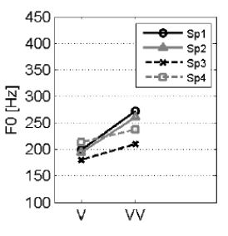
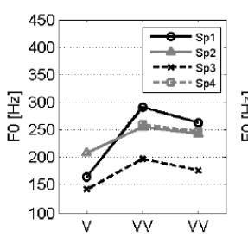
Halh (Khalkha Mongolian)
Misperception of H tone as stress
Conjecture: Every word has a %LH tune
L
H
L
H

Slide 61
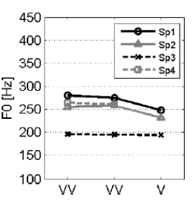
Halh (Khalkha Mongolian)
LH

Slide 62
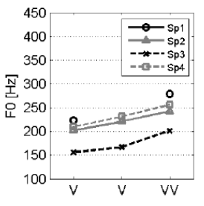
Halh (Khalkha Mongolian)
Reduced vowels are very short
  So the H target is realized later
V ə V
L
H

Slide 63
Is Chukchi evidence?
Have we seen any evidence that there is (or was) some PhM that generated the stress outputs asserted by the various descriptions?
By examining the theory, we identified points of potential ambiguity in the source of the perceived realization of PhM metrical heads
  For every point of ambiguity, the theory requires a disambiguation
  which mandates a methodology, implemented by techniques – many of which already exist and are well known

Slide 64
Is there any evidence for s-d stress?
Not "Is there sonority-driven stress?"
But rather:
  Is there any case cited in the literature where the methodological concerns of Generative phonology are addressed?
None so far, but I'm still going through them in detail
  However, so far …

Slide 65
Characteristics of s-d stress evidence
No/little subject information
Little phonetic information; very little objective phonetic work; almost always impressionistic
Generalizations (and negative implications) are often not adequately supported by data
Very few sources refer to stress-sensitive phonological processes
When there is replication, there is almost always disagreement

Slide 66
Why this is (partly) my fault
There might be phonologists who believe that there is such a thing as sonority-driven stress because of my work
If you believed me, that was your mistake
  You should have demanded adequate evidence
But let's blame me for argument's sake
Can I pass the blame on to anyone else?

Slide 67
No.
The sources I used did not claim to be about the PhM
Castrén did not know about Generative phonology in 1854, so cannot be blamed for his generalizations about Nganasan
  I interpreted Castrén's claims as being about the PhM
  That was my intellectual leap – an unjustified assumption
The responsibility always lies with those who repurpose a description for a novel use

Slide 68
Beyond sonority-driven stress
Are there QI iambs?
Is there onset-driven stress?
Default to opposite stress?
Default to same side stress?
Iambs?
Which consonants can be epenthesized?

Slide 69
In the journal Phonology
25% of the datasets are primary
  Work where the author has done some elicitation/experiment
75% are secondary
  They report published descriptions
Reporting subject properties is very rare for secondary datasets

Slide 70
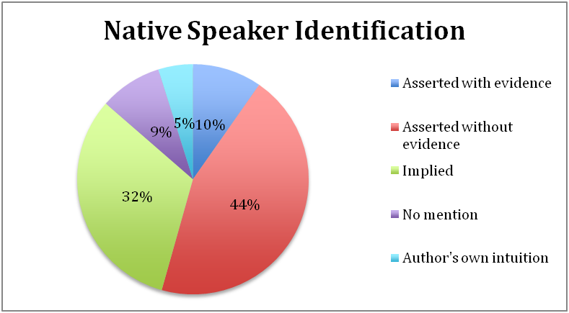
Phonology: Native speaker id/Primary
Fremed (2013); de Lacy (in prep.)
Native speaker identification in Primary datasets in Phonology1999-2102

Slide 71
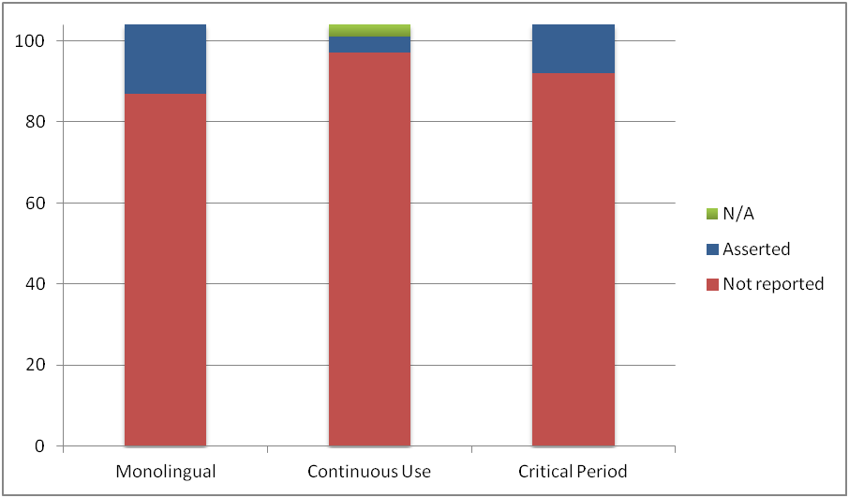
Phonology: 'Native speaker' criteria
Crucial 'native speaker' properties in Phonology for Primary datasets

Slide 72
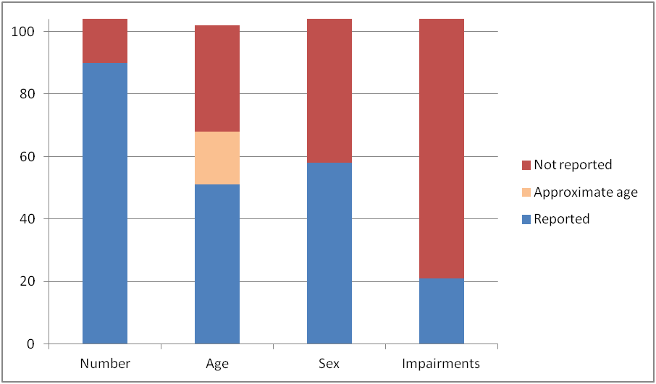
Properties of Primary dataset subjects

Slide 73
Pooling in Phonology
Pooled | 30 (8.4%)
Not pooled | 15 (4.2%)
Not reported | 314 (87.5%)
Total | 359

Slide 74
Reporting: Cognitive or Physical Impairment
 | Not reported | Asked | Did not ask
All (359) | 97.8% | 2% | 0.2%
Primary (60) | 92.4% | 6.8% | 0.8%
Secondary (268) | 100% | 0% | 0%

Slide 75
Has the field changed?
Yes: there's more in-lab experimentation
Is this better?
The problems I've talked about today are due to
  acceptance of other field's techniques (e.g. anthropology, descriptive taxonomy, psychology, sociology)
  without considering whether those techniques are justified in Generative phonology
Are we just importing bad techniques from other fields for in-lab experiments, too?

Slide 76
The arms race
There is always an arms race between theory and evidence
  Theories develop and make empirical predictions
    Evidence then needs to catch up
  Unexpected data is discovered
    Theories then need to change
We have many interesting theories right now
  We need to understand how to find evidence for them

