Slide 1
Phonological Theory Agora 2019
Markedness In
PHONOLOGICAL
Cognition
Tutorial
2019-03-16
Paul de Lacy
Professor Emeritus, Rutgers University
delacy@rutgers.edu
http://www.pauldelacy.net/agora

Slide 2
Goals
« What is not agreed, however, is if markedness and melodic primes are universal properties of language, and thus a part of UG and innate, or if they are emergent patterns based on environmental information gathered by the child. »
  Tobias Scheer, p.c.
“Would you consider … taking on the classical position where the set of features and/or markedness constraints is universal and part of UG?”
  Tobias Scheer, p.c.
Is markedness universal?
Is markedness innate?

Slide 3
Structure
A: What is markedness?
B: Where is markedness (in formal terms)?
C: Theory of markedness
D: Does markedness require universal features?
E: How do we discover markedness? (Methodology)
F: Evidence for markedness
G: Current issues in markedness
Argument
  Theory -> Responsibility
  Methods -> Evidence
  Do we know anything?
    No.

Slide 4
A: What is markedness? Non-cognitive tradition
Ambiguous! Taxonomy vs. Cognition
Taxonomic markedness
  Taxonomic goal: To describe and classify languages
  Markedness: A means of description and classification
  “The greatest use of such explicit structural descriptions [as in Harris 1957] will be in the cataloguing of language structures, and in the comparing of structural types.“ (Harris 1957:3)
“Language” = definition(?)
  Communicative system used by members of some community
“Markedness” = definition
  “prototypicality”, where there are prototypical inventories, structures, etc.
  Certain elements (segments?) are common in inventories and corpuses, learned early, and so on

Slide 5
A: What is markedness? Non-cognitive tradition 2
[t] occurs in lots of consonant inventories
[q] does not occur in many inventories
Therefore, [q] is more marked than [t]
We can classify languages based on their inventory markedness
We can classify them based on their inventories:
  [t q] vs [t]
  No (or rare) languages with [q] but no [t]

Slide 6
A: What is markedness? Cognitive 'tradition'
Which tradition?
  SPE chapter 9
  … de Lacy (2006) Markedness
  and many others
What does ‘markedness’ mean for cognitive theories?
  Specifically Generative ones
  Specifically about the Phonological Module (PhM)
Let’s define states…

Slide 7
A: What is markedness? Cognitive 'tradition'
State of the PhM
  Input = any permissible input structure (i.e. not just lexical items)
  A complete input->output mapping set
  All possible inputs and (all of) their mappings to outputs
  There are many possible PhM states
A “grammar” is a mechanism that describes a state (rules, constraints, etc.)
Inputs | /in1/ | /in2/ | /in3/ | /in4/ | /in5/ | …
Outputs | [out1] | ∅ | [out2] |  | [out3] | …

Slide 8
A: What is markedness? Cognitive 'tradition‚ 2
Are there asymmetries in states?
  i.e. are there definable states that don’t exist in the PhM?
Suppose we examine all possible states of the PhM
  Some state(s) in which /p/->[t] in codas: e.g. /ip/ -> [it]
  No state in which /t/->[p] in codas: e.g.  /it/ -> [ip]
  This is an ‘asymmetry’
  We need a theory of such PhM state asymmetries
A theory of PhM state asymmetries is a theory of PhM markedness

Slide 9
A: What is markedness? Taxonomic vs. Cognitive
There are big differences between taxonomic and cognitive markedness
Object of study
  Taxonomic: ‘language’
  Cognitive: PhM states
  Caveat: Phonologists lazily use the term ‘language’ when they mean ‘state’ (or more often ‘grammar’)
Generality
  Taxonomic: all factors relevant to a language
  Cognitive: only asymmetries in the PhM, not other modules or mechanisms

Slide 10
A: What is markedness? Other markednesses
Optimality Theory “markedness constraints”
  Should be called ‘output constraints’
  OT’s markedness constraints do not implement a theory of markedness
  Both markedness and faithfulness constraints are needed to explain asymmetries

Slide 11
A: What is markedness? Summary
The rest of this talk focuses on cognitive markedness, specifically in Generative theories
‘Markedness’ refers to PhM state asymmetries
A theory of markedness is a theory of PhM state asymmetries
Are there any PhM state asymmetries?
Where would we look?

Slide 12
B: Where is markedness?
Taxonomic markedness
  Largely about ‘surface’ properties – directly visible ones
  Phoneme theory complicates things – definitely not about direct surface properties
Taxonomic legacy in cognitive theories
  A great deal of work on ‘markedness’ focuses on outputs.
Where else should we look?

Slide 13
B: Where is markedness? Generative model
  Lexicon /pak/, /-ta/
  PhM Input /pak-ta/
  PhM Output [paʔta]
  ... ultimately speech sounds: « paʔta »
In the input
In the input->output
mapping
In the output

Slide 14
B: Where is markedness? The output
An output markedness observation
  “No state has output o₁ [in the context of o₂, o₃,....]“
  “No state has trisyllabic feet”
  “If a state has no [t] in its outputs, then some outputs have a [ʔ]” (deL06)
    “If a language doesn’t have a [t], it must have a [ʔ].”
A great deal of research focuses on output markedness
  But is this is where asymmetries are to be found?

Slide 15
B: Where is markedness? The output: Coda stop inventories
 |  | k | p | t | ʔ
 | markedness-compliant |  |  |  | X | Kashaya (Buckley 1994), Kelantan Malay (Teoh 1988, Trigo 1988), Toba Batak (Hayes 1986)
 |  |  |  | X | X | Chickasaw (Munro & Ulrich 1985)
 |  |  | X | X | X | Standard Malay (below)
 |  | X | X | X | X | Pendau (Quick 2000§4.2.1)
 |  |  |  | X |  | Uradhi (Hale 1976, Crowley 1983)
 |  |  | X | X |  | Formal Kiowa (Watkins 1984)
 |  | X | X | X |  | New Zealand English
 | Markedness-gapped |  | X |  | X | Nganasan (Helimski 1998)
 |  | X |  |  | X | Fuzhou (Yip 1982:646)
 |  | X | X |  | X | Yamphu, Cockney English (Sivertsen 1960)
 |  | X |  | X | X | Nambiquara (Kroeker 1972)
 |  | X |  | X |  | Mordva (Zaicz 1998)

Slide 16
B: Where is markedness? The input
Are there asymmetries in inputs?
Do we find that inputs systematically lack information found elsewhere (e.g. outputs)?
Inputs lack prosodic structure
  No contrastive syllabification
  No contrastive footing
  Yes: Contrastive main stress (see de Lacy 2018 for a theory about that)

Slide 17
B: Where is markedness? Mappings
A mapping asymmetry:
  Some states have /A/→[B]/_E
  No state has /B/→[A]/_E
/Input/ |  | [Output]
k |  | k
p |  | p
t |  | t
ʔ |  | ʔ
Important
These asymmetric
mappings can
generate
complete inventories!

Slide 18
B: Where is markedness? IO Mappings 2
See de Lacy (2006) in Theoretical Linguistics
 | /b/ | /d/ | /g/
Attested | p | t | k
No | p | t | g
No | p | d | k
No | p | d | g
No | b | t | k
No | b | t | g
No | b | d | k
Attested | b | d | g

Slide 19
B: Where is markedness? Representation & Computation
Computational markedness
  When a computational mechanism applies to one structure/mapping, but not the inverse
  e.g. /dorsal/ -> [coronal] /__σ, but not /coronal/ -> [dorsal]/ __σ
  e.g. *dorsal, but no *coronal
Representational markedness
  Classic: complexity
  When structure A is more complex than B (e.g. B is a proper substructure of A)
  The computational system refers to that complexity
No

Slide 20
C: Principles of markedness in de Lacy (2006)
Markedness hierarchies
  are feature hierarchies: Orders between feature values
  Voice: [+voice] > [-voice]
  PoA: dorsal > labial > coronal > glottal
  Onset sonority: onset/glides,laryngeals > onset/liquids > onset/nasals > onset/obstruents
  Head sonority: FtHd/ə > FtHd/i,u > FtHd/e,o > FtHd/a
Markedness hierarchies are converted into constraints
Markedness hierarchies are not segment hierarchies
  There is no “least marked segment“
Consequence: segments can clash in markedness
  e.g. ʔ is unmarked in PoA, but marked in sonority
No

Slide 21
C: Principles of markedness in de Lacy (2006) (GIMF)
Preservation of the Marked
  In rule-based theories, `preservation‘ refers to rule non-application
  In parallelist theories, ‘preservation’ refers to specific constraints (e.g. faithfulness)
  In OT: for a hierarchy A>B, there are faithfulness constraints F(A), F(A,B), but no F(B).
Example: Coda /t/->[ʔ] in Yamphu, but [k] and [p] do not
some
No
/akmat/ | Faith (dorsal) | *dorsal | *dors,lab,cor | Faith (dors,lab,cor)
ak.mat |  | * | * *!
aʔ.maʔ | *! |  |  | * *
aʔ.mat | *! |  | * | *
 ☹ ak.maʔ |  | * | * | *

Slide 22
C: Principles of markedness in de Lacy (2006) (GIMF)
Markedness conflation
  If A > B, does this mean:
“A is more marked than B”
or “B is never more marked than A”?
Conflation is a fairly complex topic
  Avoid stressed [i] and [e] equally, even though stressed [e] is less marked than stressed [i]
Conclusion: B is never more marked than A.
  Perhaps we should represent markedness as: A ≥ B
some
No

Slide 23
C: Principles of markedness in de Lacy (2006) (GIMF)
Summary
(a) Hierarchies are featural, not segmental
  Therefore, we can expect some segmental markedness contradictions
(b) Markedness reduction: A>B licenses /A/→[B]
(c) Markedness preservation: A>B licenses /A/→[A] even if /B/→[B’]
(d) Markedness conflation: A≥B, not A>B
some
No

Slide 24
D: Is markedness universal and innate?
What does “Is markedness universal?” mean?
  deL06: Are feature value hierarchies and the computational mechanisms that refer to them (e.g. constraints) found in every PhM?
  Answer: Yes, otherwise there would be no universality of consequences
“Can we have markedness (i.e. PhM state asymmetries) without universal features?”
  No.
  It is not possible to have feature value hierarchies without having the features that they refer to.
“If we have universal features, must we have universal markedness?”
  No.
  However, defining a theory that has no asymmetries anywhere is not trivial!
If someone says “The phonological module can do anything!”
  Ask “What is your PhM theory?”

Slide 25
E: Discovering markedness
Where do we get our evidence for the PhM?
Observations from ‘devices’
  Human perception (e.g. in fieldwork)
  Interpretation of spectrograms (by human or algorithm)
  Interpretation of grammars
  etc.
Problem: No device that sees PhM inputs/outputs directly
some
No

Slide 26
Generative PhM-containing Theory and Devices
For some human, some PhM, in some state …
Human
Other cognitive influences (e.g. memory, attention)
Brain
Lexicon
Syntax
Morphology
Phonological Module
Phonetic Module
Neuro-motor interface
Articulators
Transmission medium
Articulator state detectors
Acoustic perceptual devices (Human, Machine)

Slide 27
E: Discovering markedness: The cognitive contribution
For any observation:
  what is the contribution of the PhM?
  what is the contribution of other modules/mechanisms?
Example: /ʔ/ transference
  We deduce that there is an input /paʔ/, yet detect «pa̰»
some
No
 | Option A | Option B | Option C
PhM input | / paʔ / | / paʔ / | / paʔ /
PhM output | [ pa̰ ] | [ paʔ ] | [ paʔ ]
Phonetic module output | [[ pa̰ ]] | [[ pa̰ ]] | [[ pa̰ʔ ]]
Speech sounds | << pa̰ >> | << pa̰ >> | << pa̰ >>

Slide 28
E: Discovering markedness: The cognitive contribution
“[s] is found in 80% of languages, and so [s] is quite unmarked”
  A taxonomic statement; not a cognitive one
Translating into something cognitively expressible
  There is some PhM state in which some output contains [s]
  There is some PhM state in which [s] does not occur in any output
If there is a ‘language’ with [s], then we could assume that there is some human who has an L1 intact PhM that generates [s]
  This is not actually a reasonable assumption, but let’s assume it anyway.

Slide 29
E: Discovering markedness: The cognitive contribution
What we can know:
If, for some human, /A/->[B], then there is at least one PhM state in which /A/->[B]
  Assuming human PhM homogeneity
Compare: “Every language has a [t], except Hawaiian”
  Translation: “There are PhM states with [t] and states without [t].”
What about “80% of PhM states have some output that contains [s]”
  Not valid!
  Assumes that “language” = PhM state!
  Guns! Germs! Steel!

Slide 30
F: Evidence for markedness: A practical example
Is consonant epenthesis evidence for markedness?
First question: What is epenthesis?
deL06: An epenthetic consonant is one which has no input correspondent.
  In non-assimilative environments, epenthetic consonant quality can only be determined by output constraints.
  Output constraints are constructed via markedness hierarchies
  Therefore, non-assimilative consonant epenthesis provides (relatively!) easy insight into markedness hierarchies.
/p a - i /
p a ʔ i

Slide 31
F: Evidence for markedness: A practical example
Staroverov (2014): Epenthetic consonants ALWAYS have input correspondents.
Consequence of Staroverov (2014)’s theory:
  Epenthetic consonants (almost?) never show the direct effect of output constraints, and therefore markedness hierarchies.
  Makes different predictions from deL06‘s theory: i.e. just glides and laryngeals
Point: It‘s not possible to say “X is evidence for markedness“
  It‘s necessary to specify the theory.
/p a - i /
p a ʔ i

Slide 32
F: Evidence for markedness: A practical example
Assuming deL06’s theory...
How do we detect epenthetic consonants?
  A: the theory tells us
  For any putative epenthetic consonant C, we must demonstrate that:
    C is lacking in the input
    C is not influenced by assimilation or dissimilation
How hard is it to do this?
  Quite hard: de Lacy & Kingston (2013)
  Alternations!
  Not suppletive allomorphy!
Epenthetic ʔ: Sample evidence
[po] root1
[poʔa] root1 + affix1 (ʔ appears!)
[noʔ] root2 (so root1 is not /poʔ/!)
[poka] root3 + affix1 (so af1 is not /ʔa/…)
[akʔa] root4 (as long as [kʔ] is allowed)

Slide 33
F: Evidence for markedness: A practical example
How do we ‘prove’ a statement like “[k] is never default-epenthetic”?
i.e. there is no PhM state in which ∅ -> [k] (modulo assimilation/dissimilation)
(de Lacy & Kingston 2013)
I have never observed epenthetic [k], but so what? (et alors?)
Commonality?
  How common is [k]? (97.12% of UPSID languages)
  How common is epenthesis? (??)
  What else are we assuming can be epenthetic? [p t ʔ …?]
  Roughly!: p(k) . p(epenthesis) . (1/n_epenthetic) = ???? (reasonably high?)
Learnability
  Is epenthetic [k] learnable?
  Hard to see why not. We can model its learning.

Slide 34
F: Evidence for markedness: A practical example
Is epenthetic [k] actuable?
  Yes, through misperception (de Lacy & Kingston 2013)
  Diachronic evidence: *t > k in Oceanic
Is epenthetic [k] transmissible?
  Probably.
  cf. word-initial glottal stops (easy to actuate, hard to transmit)
  cf. clicks (hard to actuate, easy to transmit)
Epenthetic [k]?
  Potentially common
  Learnable
  Actuable
  Transmissible
  Yet not attested.

Slide 35
F: Evidence for markedness: A practical example
Epenthetic [k]: diachronic path
Proto-Eastern Polynesian: p t k
Pre-Hawai’ian: p t ʔ
Hawai’ian: p k ʔ
Why isn’t [k] the epenthetic consonant here?

Slide 36
G: Bad objections to Markedness, schematically
Conflation of taxonomic markedness and cognitive markedness
  “A structure is unmarked on a dimension if it represents the default or basic state for the structure in that dimension, and marked structure adds complexity to this default state… marked structure is learned later,… is eliminated in historical sound change, implies the corresponding unmarked structure in typology…” Alderete & Davis (2018) Link
  Another example: most of the items listed by Blevins (2004:intro.)
‘Counterexamples’ without specifying which theory they’re counter to
  e.g. “Hawai’ian lacks [t], therefore [t] is not unmarked.”
  True for e.g. coronal-unmarkedness theories, not for deL06 and others
Overgeneralizing specific theoretical results
  e.g. “This [partial/disjoint class behavior] is problematic for innatist approaches which hold that all place features are expected to spread as a constituent” (Mielke 2004: 26)
  Except for any innatist theory with blocking, opacity, or dual processes (all of them?)

Slide 37
G: Bad objections to Markedness, schematically
Assuming functionalism
  e.g. “This is a crazy rule!”
  Formalist: A crazy rule for theory T is a rule that cannot exist in T.
  Functionalist: A crazy rule for theory T is a rule that cannot be generated by functional pressures.
  Craziness depends on T, and depends on formalist/functionalist philosophy.
Bad phonology
  e.g. citing a case as ‘epenthesis’ without proving it within a particular theory
  It is difficult and time-consuming to adequately prove that one has a productive PhM mapping.
    Cf. Staroverov (2014), who does it correctly.

Slide 38
G: Current Issues in Markedness
Is phenomenon X evidence for markedness?
  Depends on the theory!
  No evidence without a theory.
  No ‘atheoretism’/’theory neutrality’ (see Medawar 1969 Induction and intuition in scientific thought)
The big problem with markedness is the same problem we find with all phonological work
  Methodology
  Evidence

Slide 39
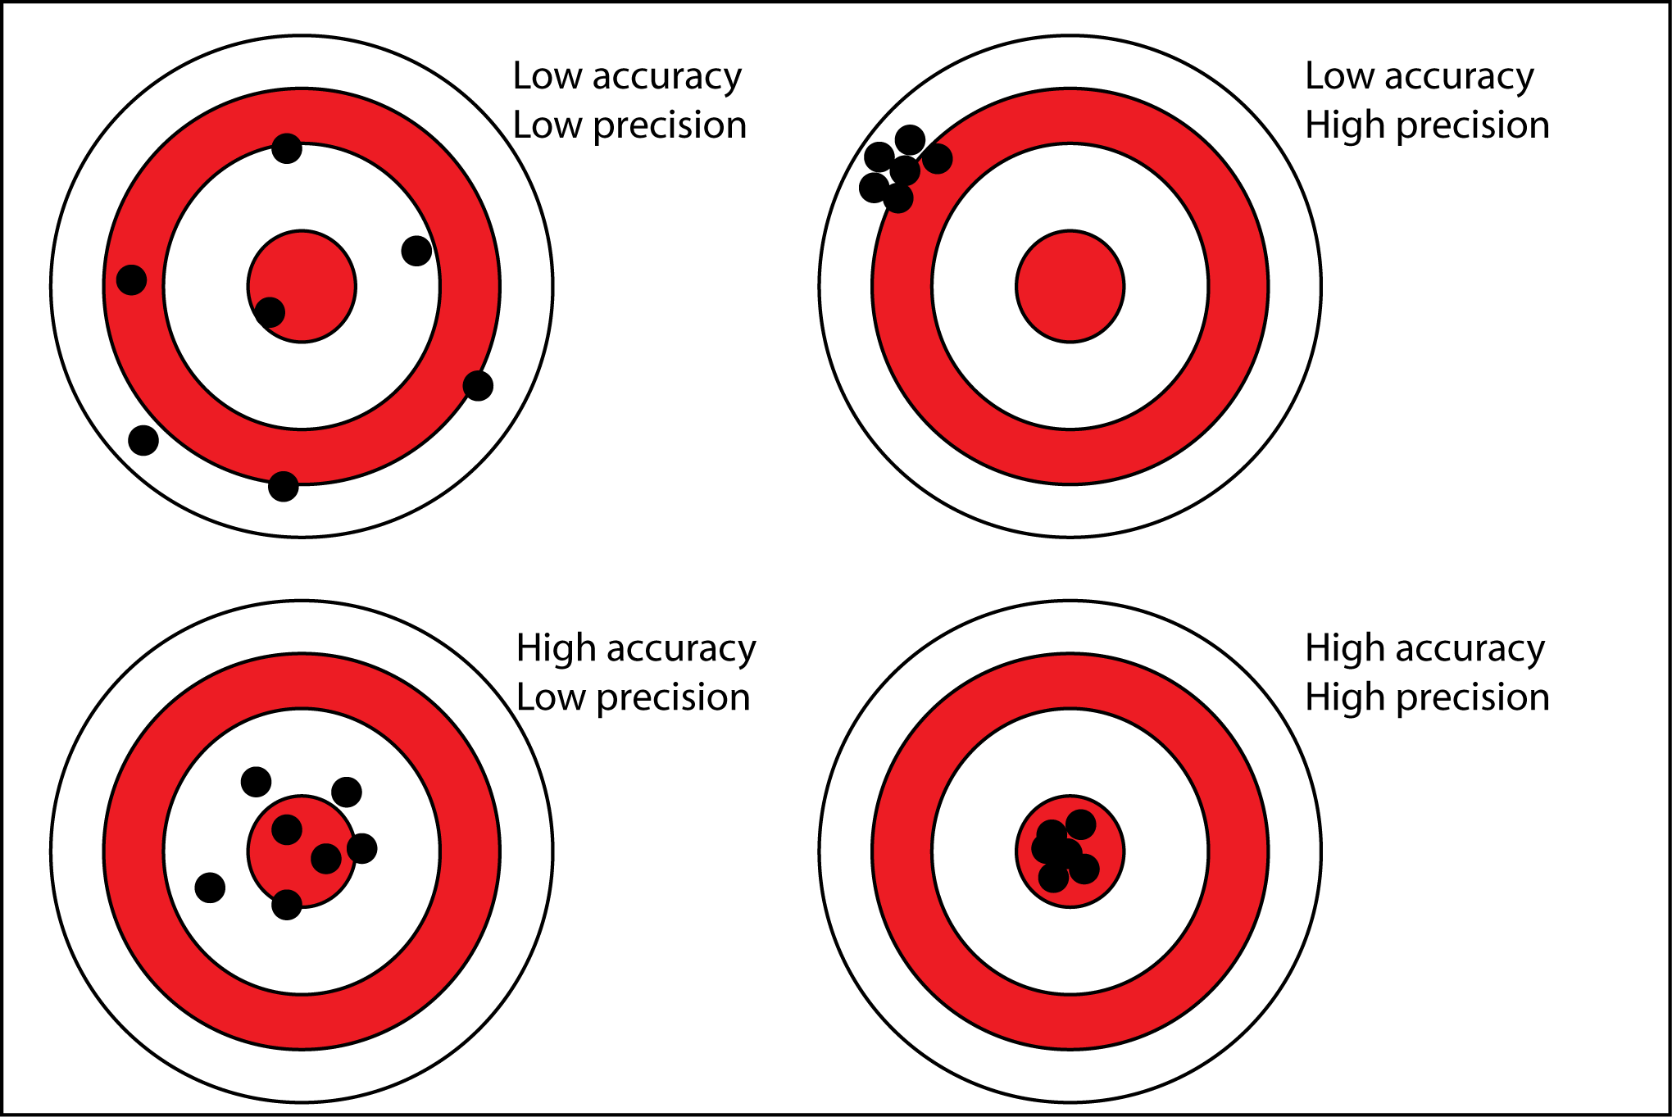
H: Methodology
For any evidence type, we have a method M of evidence collection
  Is M reliable?
  Is M precise? (How so?)
  Is M accurate?

Slide 40
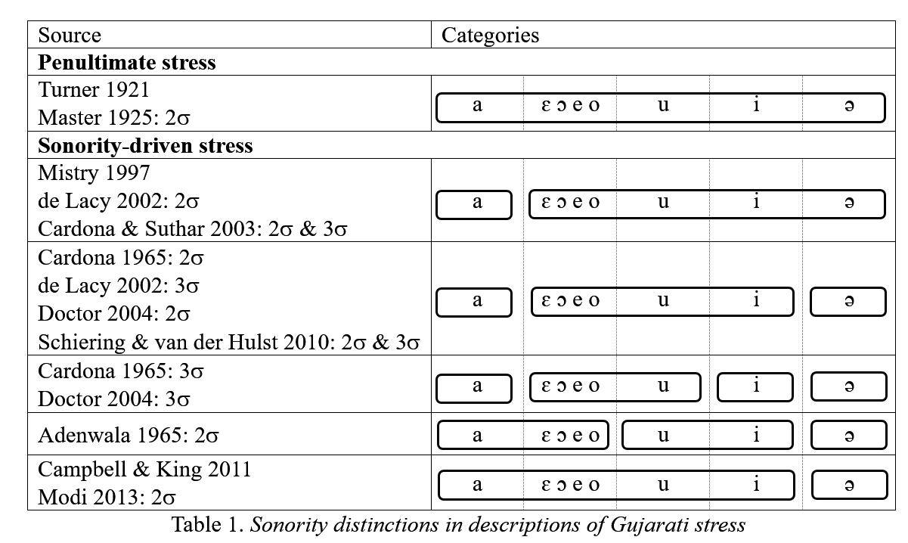
Reliability: Gujarati stress
Shih & de Lacy
to appear;
see Shih (2018a)
Phonology,
Shih (2018b) - PhD

Slide 41
Accuracy and Precision in VOT
Comparing 6 methods
of measuring VOT
Francis et al (2002)
J Acoust Soc Am 113(2)

Slide 42
Can we trust evidence for epenthesis?
Very little careful work showing that putative epenthesis is actual epenthesis
  de Lacy & Kingston (2013)
  Staroverov (2014)
Staroverov (2015)
  Showed that an apparently robust case of dorsal epenthesis (in Buryat), is not reproduced with novel morphemes
Staroverov (2014)
  Showed that Apurucayali (~‘Axininca Campa’ ☹) does not have epenthetic [t]
What’s the reliability, accuracy, and precision of epenthesis methodology?

Slide 43
Conclusions
If someone says “markedness”…
  Are they talking about taxonomic markedness or PhM state asymmetries?
If they are talking about cognition, then
  What’s the theory?
  We have a right to know!
  No evidence without a theory!
If someone says “Here is evidence for/against markedness”
  Does the PhM theory claim that it is responsible for this evidence?
  Does the theory assign responsibility to other modules and mechanisms?

Slide 44
Conclusions
If someone says “Here’s some evidence …”
  Ask “Is your method valid?”
What’s next
  We have many theories that make (more or less) clear predictions.
  Now let’s study method validity.
  Then we can figure out what our evidence is.
  Then we’ll know if PhM theories with state asymmetries (‘markedness’) are right.

Slide 45
Thanks!
Thanks to Diana Passino, Jonathan Bucci, Alex Chabot, Paolo Danesi, and Tobias Scheer for inviting me.
Thanks to whoever paid for this conference.
If my dinner is free, thanks for that, too.
Thanks to many audiences over many years for their feedback on related work (Barcelona, UDelaware, UMass, Cornell, and many others).

